Slide 1

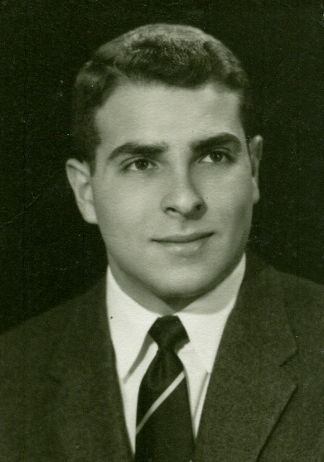
A Special Session
to
Honor the Lifetime Contributions
of
Charlotte Froese Fischer
and
Joe Reader

Slide 2
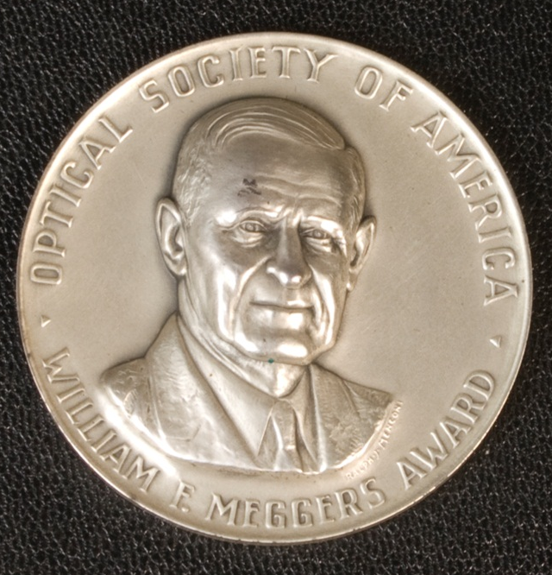
Atomic Spectroscopy at NIST, NBS
1915 - 2012

Slide 3
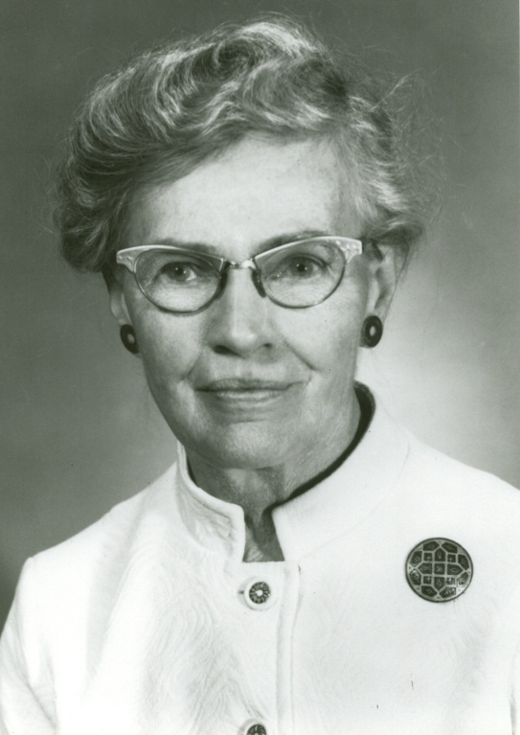
Atomic Spectroscopy at NIST, NBS
1915 - 2012

Slide 4
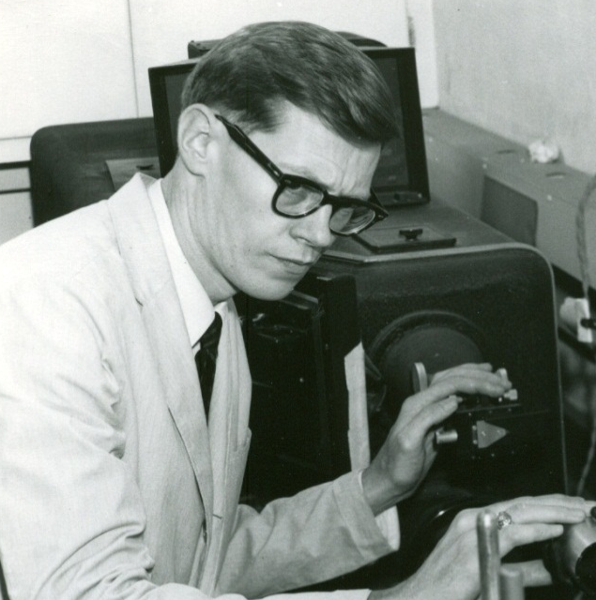
Atomic Spectroscopy at NIST, NBS
1915 - 2012

Slide 5
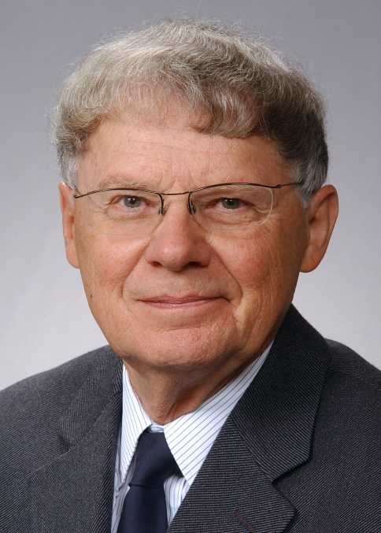
Atomic Spectroscopy at NIST, NBS
1915 - 2012

Slide 6
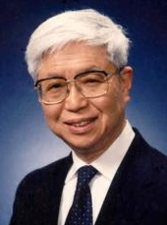
Atomic Spectroscopy at NIST, NBS
1915 - 2012

Slide 7
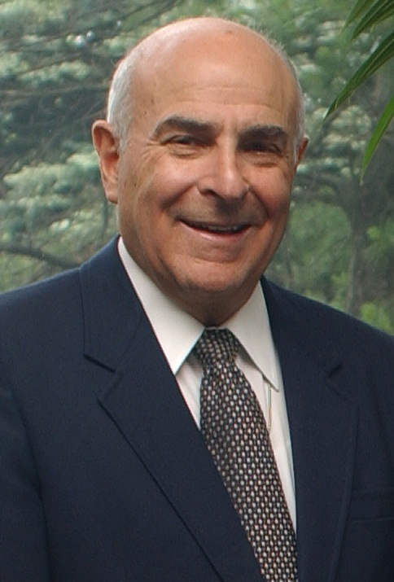
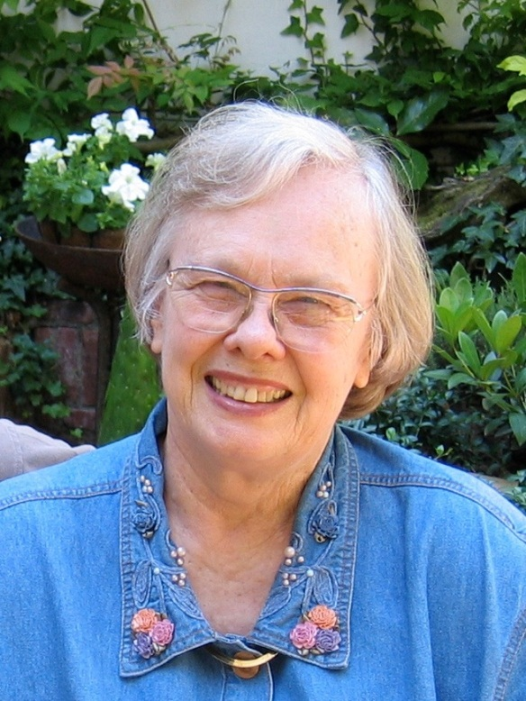
Atomic Spectroscopy at NIST, NBS
1915 - 2012

Slide 8
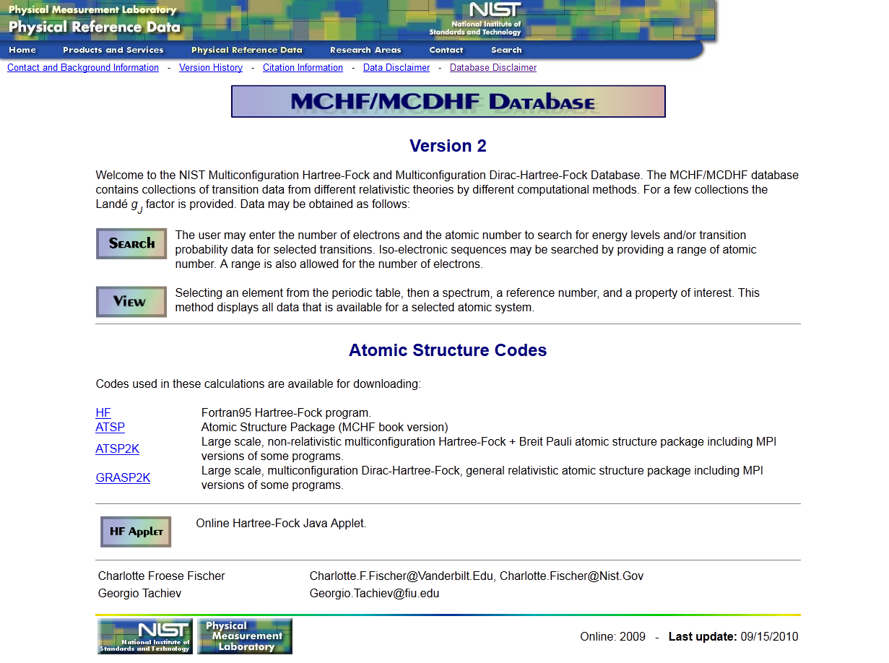

Slide 9
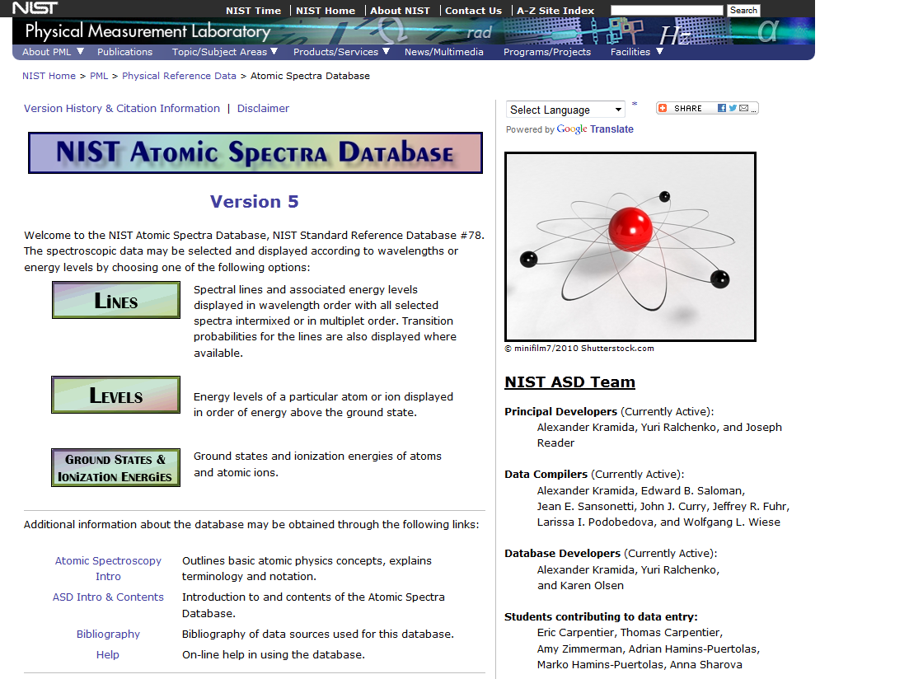

Slide 10
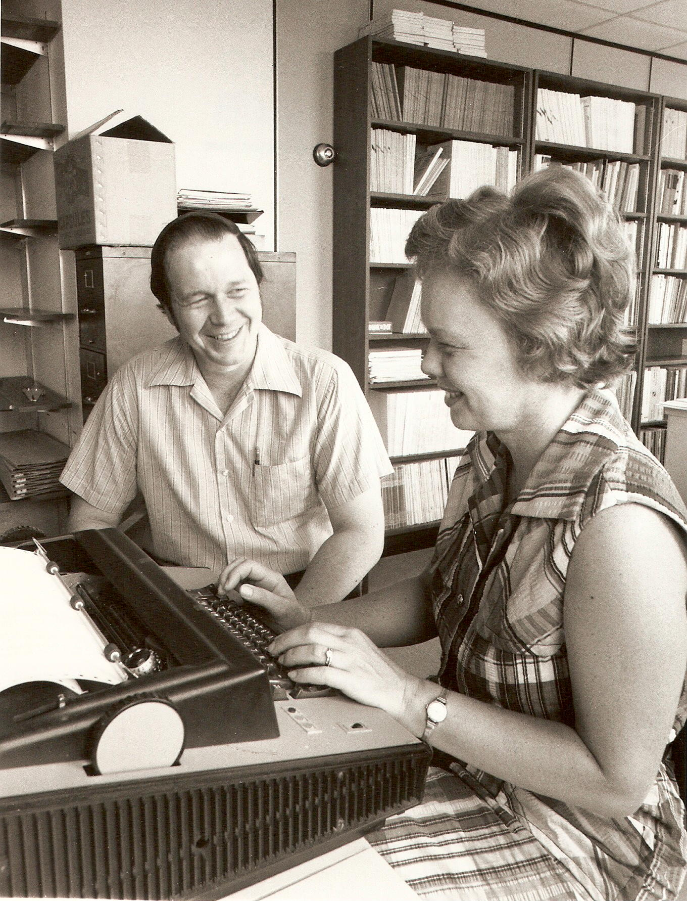
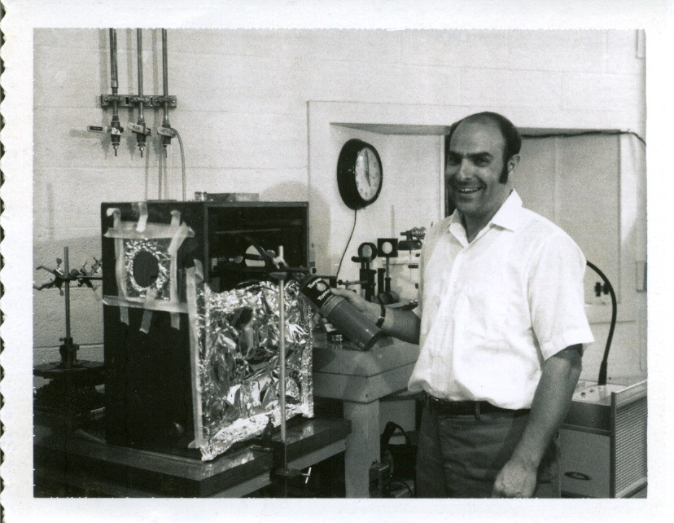
1973
1972

