Slide 1
Data of Heavy Elements for Light Sources in EUV and XUV and for Other Applications
Fumihiro Koike, Kitasato University
Collaborators:
Izumi Murakami, NIFS (National Institute for Fusion Science)
Daiji Kato, NIFS (National Institute for Fusion Science)
Hiroyuki A. Sakaue, NIFS (National Institute for Fusion Science)
Naoki Tamura, NIFS (National Institute for Fusion Science)
Shigeru Sudo, NIFS (National Institute for Fusion Science)
Chihiro Suzuki , NIFS (National Institute for Fusion Science)
Shigeru Morita, NIFS (National Institute for Fusion Science)
Takako Kato, NIFS (National Institute for Fusion Science)
Akira Sasaki, JAEA (Japan Atomic Energy Agency)
Motoshi Goto, NIFS (National Institute for Fusion Science)
Hisayoshi Funaba, NIFS (National Institute for Fusion Science)
Xiaobin Ding , NIFS (National Institute for Fusion Science)
(Northwest Normal University (Lanzhou, China)
Chenzhong Dong, Northwest Normal University (Lanzhou, China)
Nobuyuki Nakamura, UEC (University of Electro Communications)
Hajime Tanuma, TMU (Tokyo Metropolitan University)

Slide 2
Outline:
An introductory remark on the development of EUV lithography device
Demands on the knowledge of the emission spectra of atomic ions with Z ~ 50 or more.
The properties of electronic states and transition features in N-open shell atomic ions.
Calculation of many electron highly charged atomic ions
The EUV emission spectra of 13.5 nm or shorter.
Analysis of Gd and Nd spectral lines in LHD plasmas
M1 visible line emission spectra of W ions
Summary

Slide 3
Outline:
An introductory remark on the development of EUV lithography device
Demands on the knowledge of the emission spectra of atomic ions with Z ~ 50 or more.
The properties of electronic states and transition features in N-open shell atomic ions.
Calculation of many electron highly charged atomic ions
The EUV emission spectra of 13.5 nm or shorter.
Analysis of Gd and Nd spectral lines in LHD plasmas
M1 visible line emission spectra of W ions
Summary

Slide 4
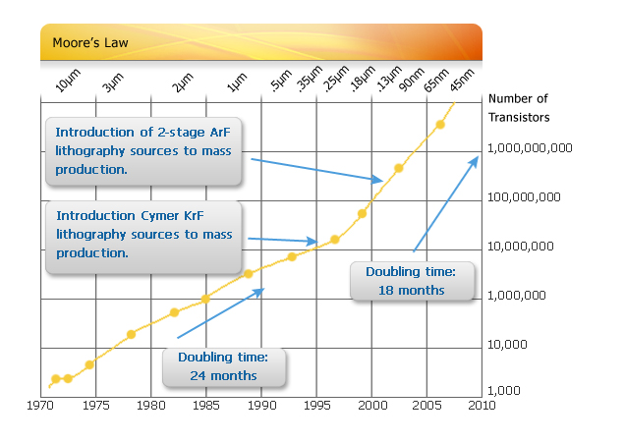
Moore’s Law for the Development of Semiconductor Devices
Use of EUV or XUV
Light Source
EUV:
100 ~ 10 nm
XUV:
10 ~ 0.1 nm
http://www.cymer.com/moores_law/

Slide 5
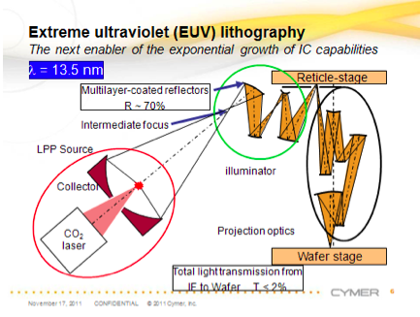
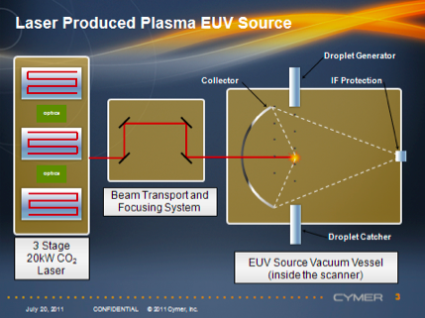
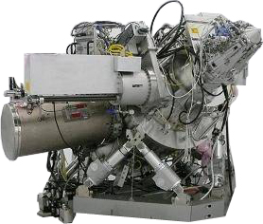
EUV lithography with LPP light source
Sn (Z=50)
http://www.cymer.com/euv_lithography/

Slide 6
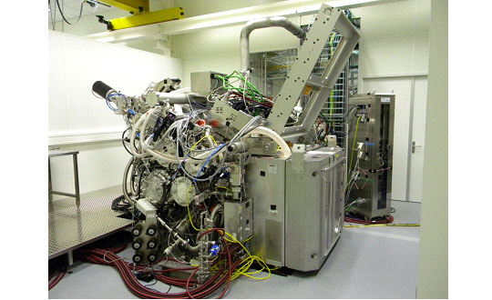
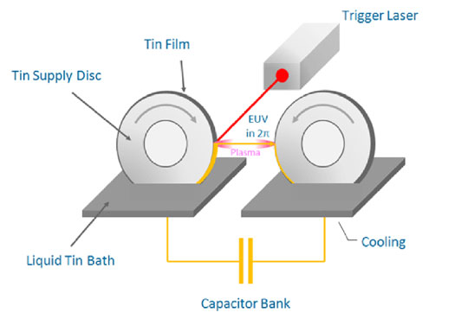
EUV lithography with DPP light source
Sn (Z=50)
http://www.ushio.co.jp/en/NEWS/products/20111027.html

Slide 7
Outline:
An introductory remark on the development of EUV lithography device
Demands on the knowledge of the emission spectra of atomic ions with Z ~ 50 or more.
The properties of electronic states and transition features in N-open shell atomic ions.
Calculation of many electron highly charged atomic ions
The EUV emission spectra of 13.5 nm or shorter.
Analysis of Gd and Nd spectral lines in LHD plasmas
M1 visible line emission spectra of W ions
Summary

Slide 8
EUV Emission Spectra from Laser Produced
Tin (Sn) Plasmas

Slide 9
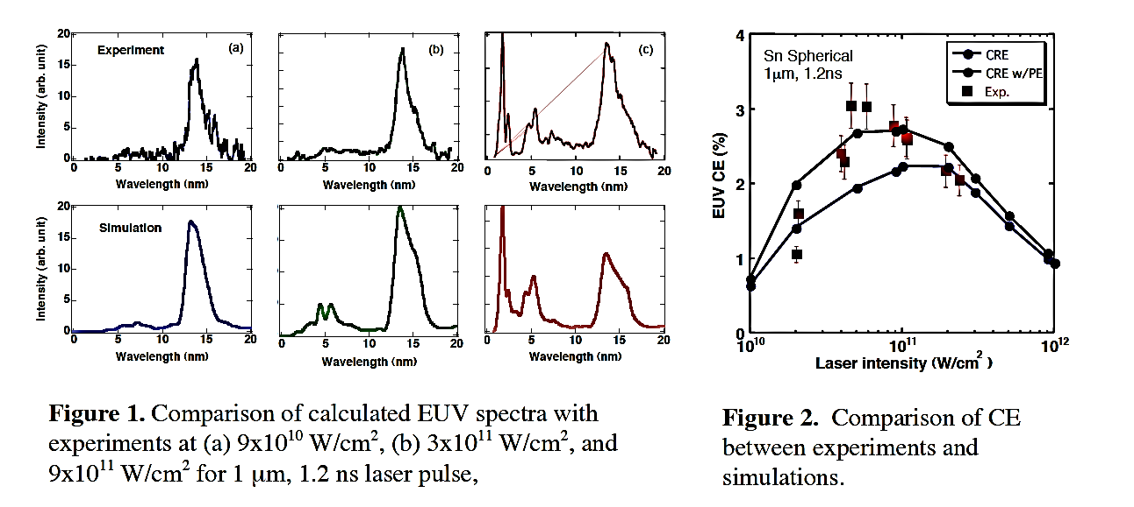
Conditions for highest conversion efficiency
EUV Light Emissions by Laser Irradiated
Tin (Sn) Plasma
Y. Izawa et al, J. of Phys. Conf. Ser. 112 (2008) 042047.

Slide 10
Role of atomic data for EUV or XUV light source development
Provide the users the emission line positions with enough accuracy but not too much for their own purpose. Too accurate data are normally too expensive in both experiments and theoretical calculations, and further they are sometimes inconvenient for further calculations of plasma properties or spectral analysis.
Provide the users the transition strengths with enough accuracy. The oscillator strength data play a crucial role for determination of the optimum plasma density and size for light source. And therefore determines the maximum output power of the light source.
Experimental:
Charge state separated atomic data.
Theoretical:
Charge and state separated atomic data.
Provide the users the data of electron scattering, charge transfer between the atomic ions, excitation transfer or collisional de-excitation between the atomic ions.

Slide 11
Outline:
An introductory remark on the development of EUV lithography device
Demands on the knowledge of the emission spectra of atomic ions with Z ~ 50 or more.
The properties of electronic states and transition features in N-open shell atomic ions.
Calculation of many electron highly charged atomic ions
The EUV emission spectra of 13.5 nm regime.
Analysis of Gd and Nd spectral lines in LHD plasmas
M1 visible line emission spectra of W ions
Summary

Slide 12
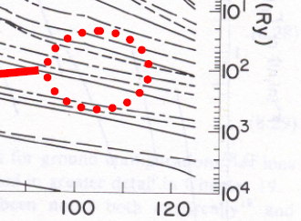
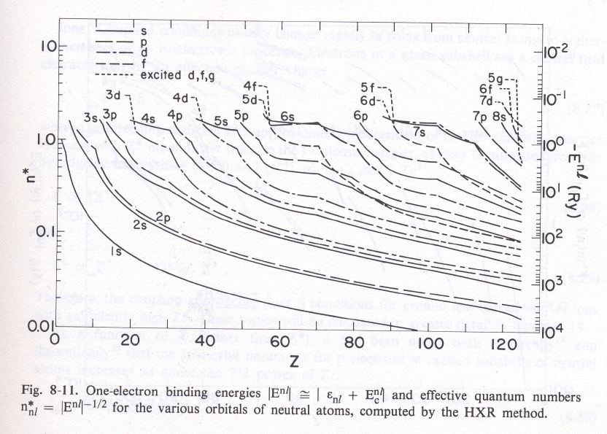
Z-Dependence of
Single Electron Orbital Energies
4f
4d
4p
4s
R.D.Cowan, The Theory of Atomic Structure and Spectra (Berkeley,1981)

Slide 13
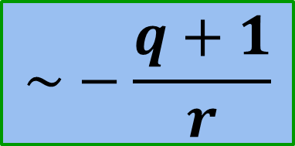
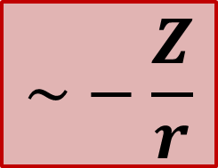
Characteristics of quasi Coulombic systems
Effective nuclear attraction potential for individual electrons
One electron orbital levels with the same principal quantum number n :
ns, np, nd, …
Non-Coulombic area
Z

Slide 14
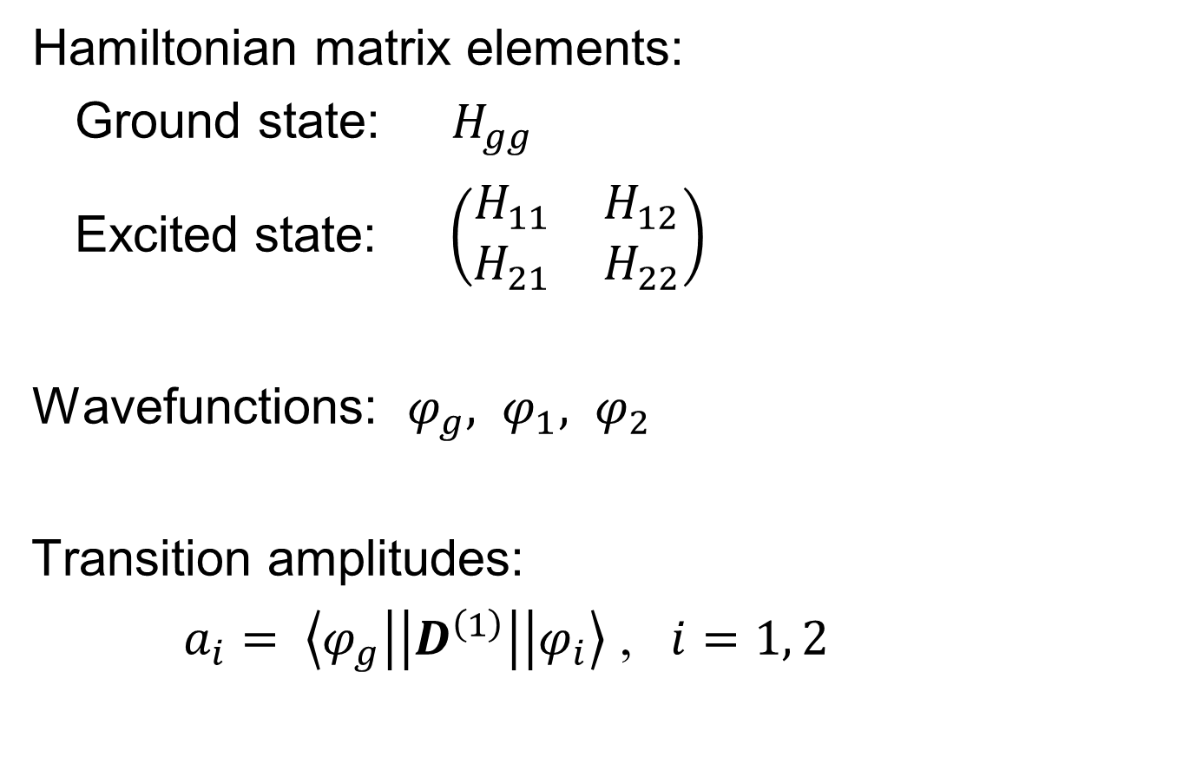
Mixing of two levels in Quasi Coulombic Systems (1)
J. Bauche, C. Bauche, et al, J. Phys. B20 (1987) 1443-1450

Slide 15
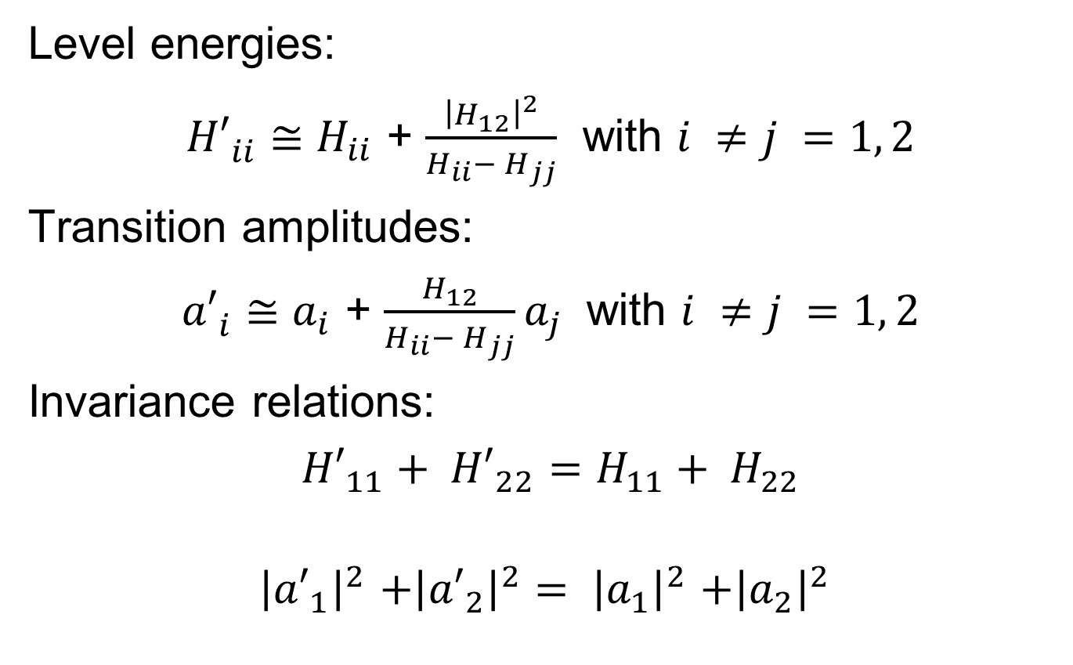
Mixing of two levels in Quasi Coulombic Systems (2)
J. Bauche, C. Bauche, et al, J. Phys. B20 (1987) 1443-1450

Slide 16
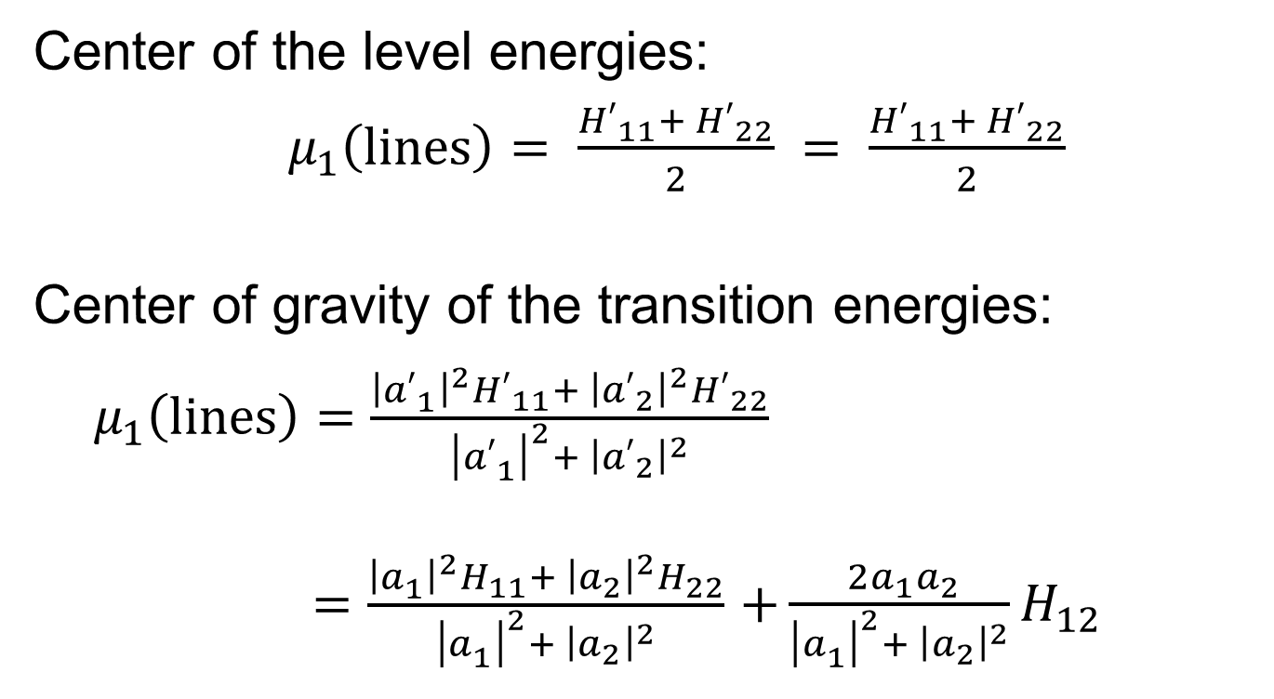
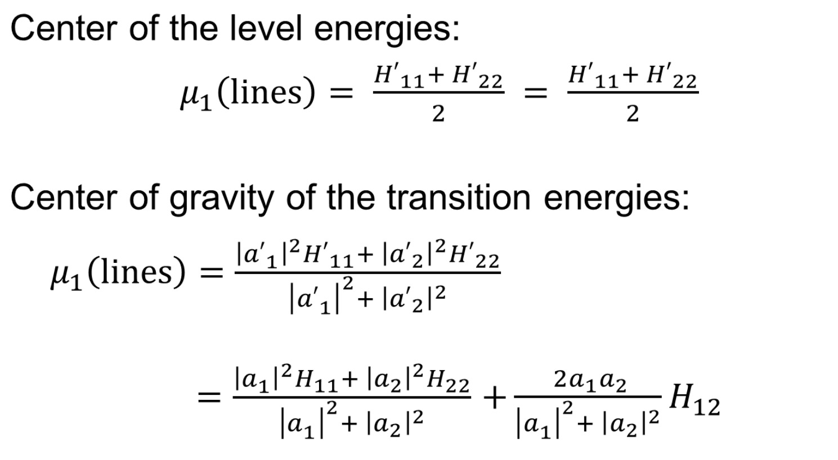
Mixing of two levels in Quasi Coulombic Systems (3)
The shift is large
when a₁, a₂, and H₁₂
are enough large.
Shift of UTA center
J. Bauche, C. Bauche, et al, J. Phys. B20 (1987) 1443-1450

Slide 17
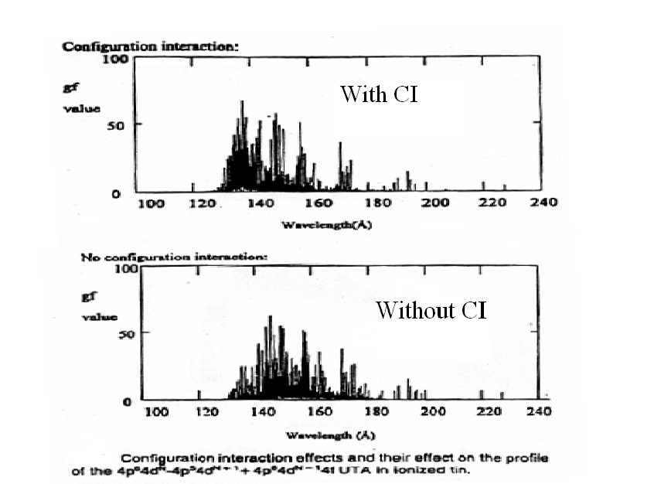
Earlier discussions on the spectral shift and narrowing due to the configuration interaction
Superposition of pure arrays
Configuration Mixing of
4p⁶4d4f and 4p⁵4d³
is
accounted for
Shift
Sn Ions
4d – 4f and 4p – 4d Transitions
4p⁶4d² – 4p⁶4d4f and 4p⁶4d² – 4p⁵4d³
Transitions of Pr XXII
J. Bauche, C. Bauche, et al, J. Phys. B20 (1987) 1443-1450
G. O’Sullivan, and R. Faukner, Opt. Eng. 33, 3978 (1994)

Slide 18
Outline:
An introductory remark on the development of EUV lithography device
Demands on the knowledge of the emission spectra of atomic ions with Z ~ 50 or more.
The properties of electronic states and transition features in N-open shell atomic ions.
Calculation of many electron highly charged atomic ions
The EUV emission spectra of 13.5 nm or shorter.
Analysis of Gd and Nd spectral lines in LHD plasmas
M1 visible line emission spectra of W ions
Summary

Slide 19
Key effects to the electronic structure of open-shell atomic ions
Treatment to the non-local two electron potential
&
Atomic Codes

Slide 20
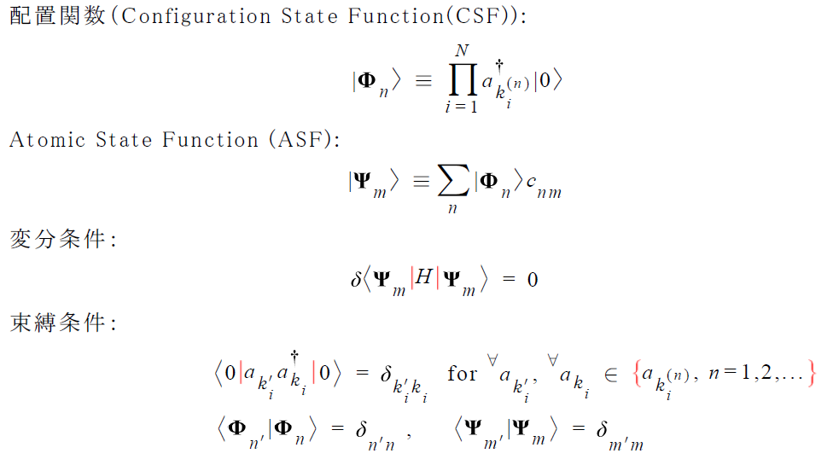
Overview of Multi-Configuration Method
Configuration State Function (CSF):
Variational Condition:
or
Constraint:
Make the first order variation of the orbitals to zero

Slide 21
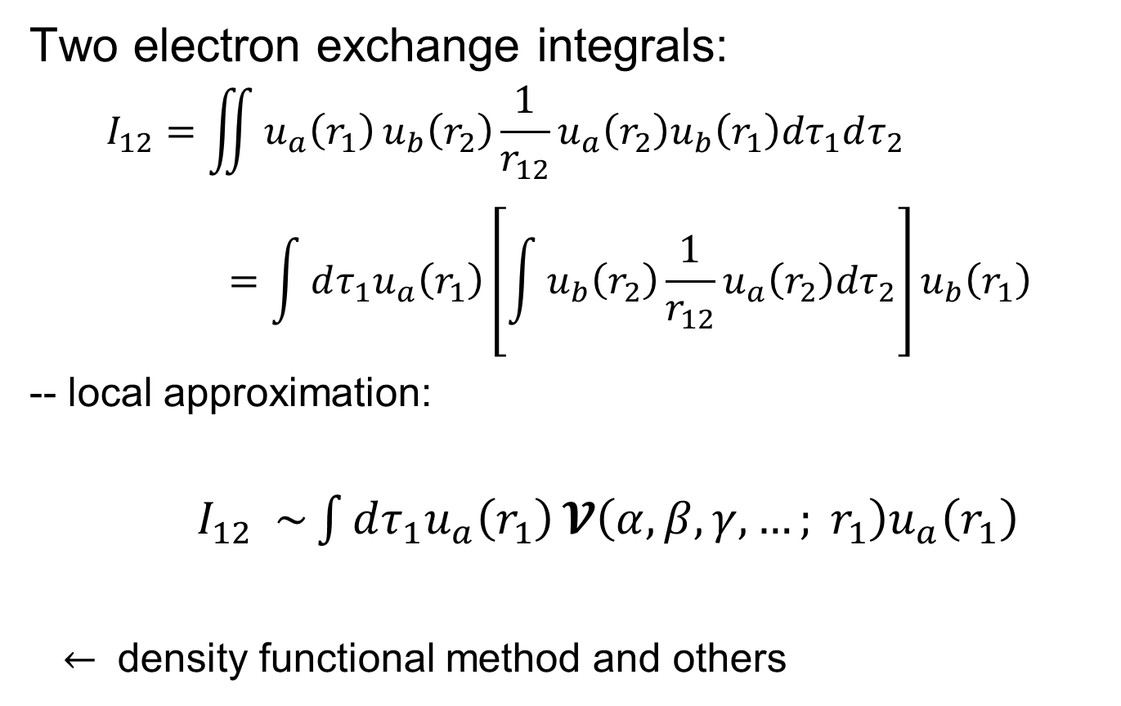
Treatment of non-local two-electron interactions

Slide 22
The use of GRASP family of codes
GRASP and GRASP2
-- Very convenient for simple calculation with batch mode user interface
K. G. Dyall, et al., Comp. Phys. Communications, 55, 425 (1989).
F. A. Parpia, et al, unpublished version of GRASP: GRASP2.
GRASP92 + RATIP
-- Interactive user interface that is convenient for sophisticated types of calculations.
-- In combination with RATIP code package, several types of transitions such as Auger processes may be calculated
F. A. Parpia, et al., Comp. Phys. Communications,94, 249 (1996).
S. Fritzsche et al., Phys. Scr. T80, 479 (1999).
GRASP2K
-- Gives wide range of applicability.
P. Jonsson et al., Comp. Phys. Communications, 177, 597 (2007).

Slide 23
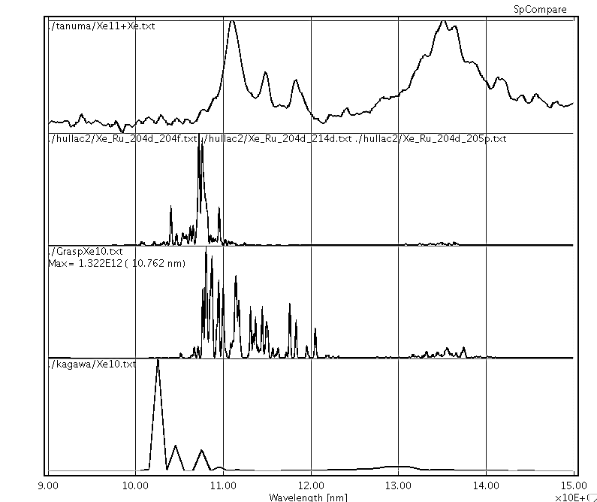
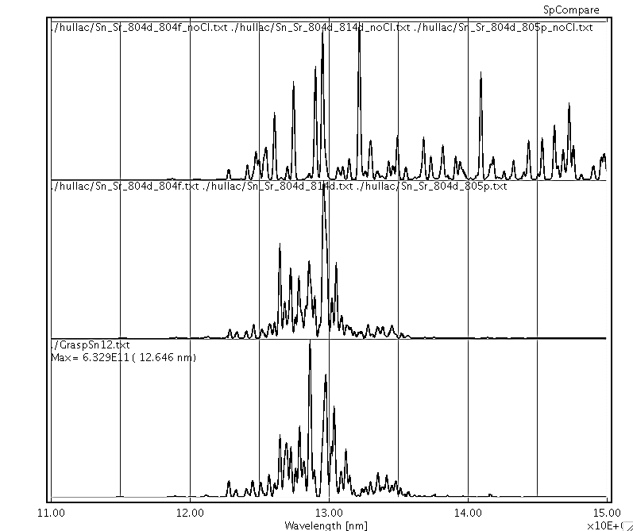
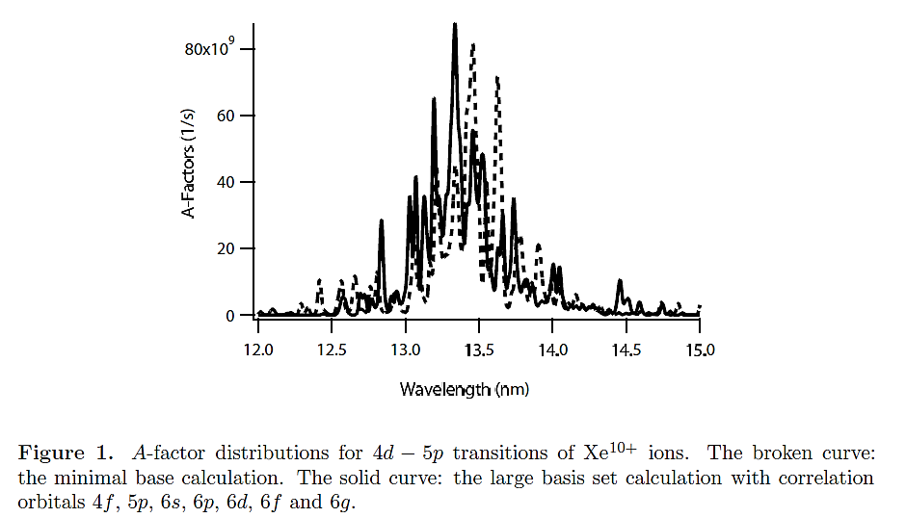
Comparison between GRASP and HULLAC, the CI effects
Xe¹⁰⁺
Sn¹²⁺
HULLAC
W/O CI
CXS, TMU
Broken line : minimal base calculation.
Solid line: large scale CI calculation
HULLAC
HULLAC
With CI
GRASP
GRASP
With CI
12 13 14 15
RCI
Wavelength (nm)
F. Koike, S. Fritzsche, K. Nishihara, J. Phys. Conf. Ser.58 (2007) 157-160

Slide 24
Outline:
An introductory remark on the development of EUV lithography device
Demands on the knowledge of the emission spectra of atomic ions with Z ~ 50 or more.
The properties of electronic states and transition features in N-open shell atomic ions.
Calculation of many electron highly charged atomic ions
The EUV emission spectra of 13.5 nm or shorter.
Analysis of Gd and Nd spectral lines in LHD plasmas
M1 visible line emission spectra of W ions
Summary

Slide 25
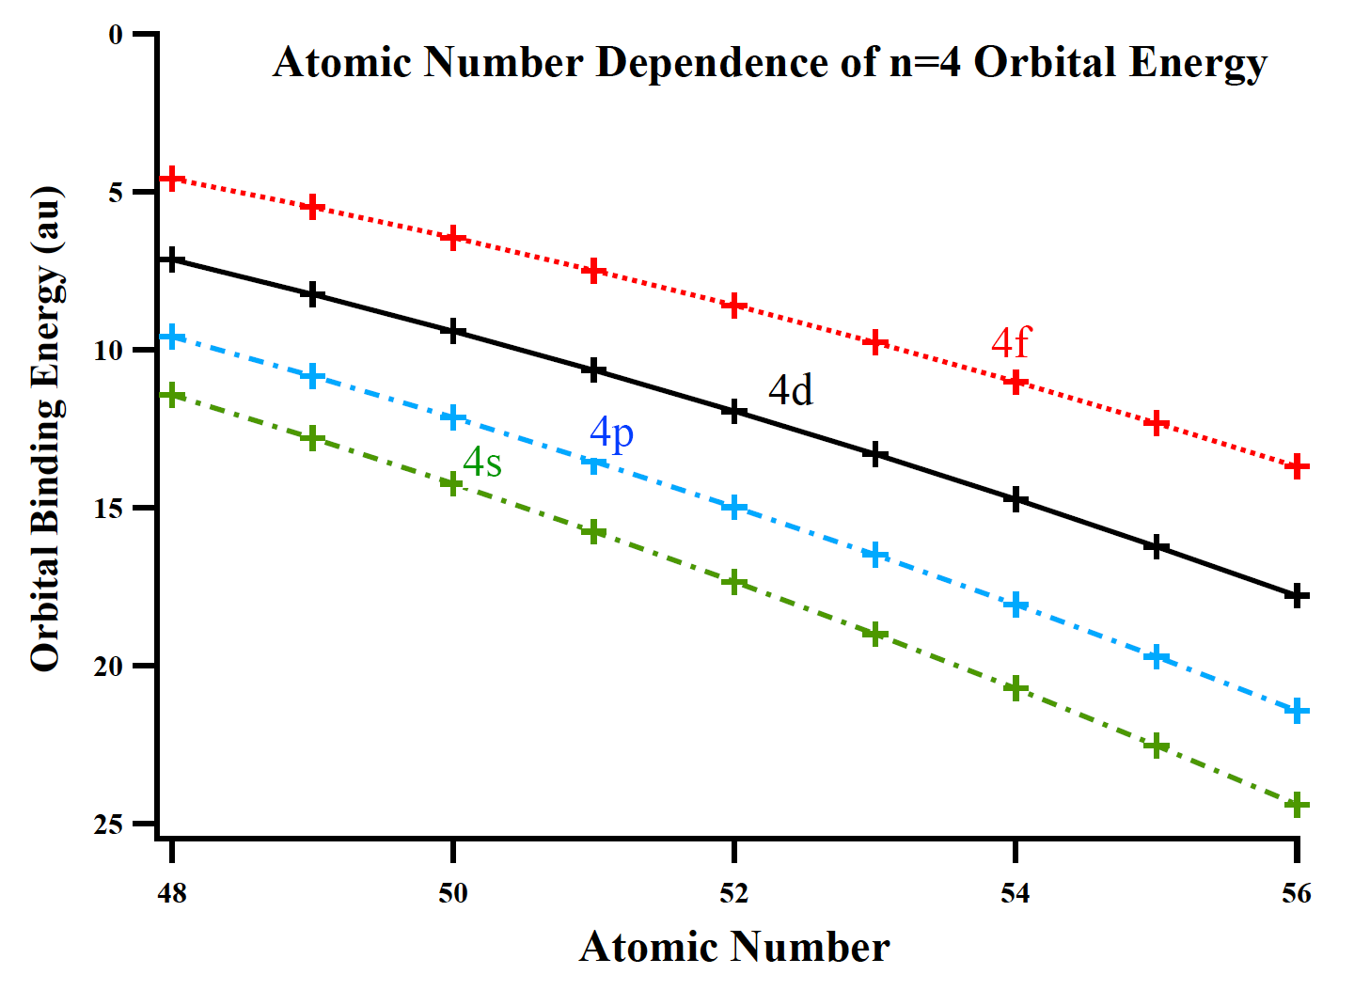
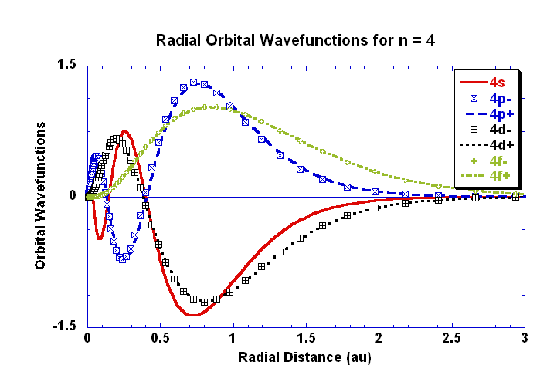
Orbital wavefunctions and orbital energies
Sn¹²⁺
… 4s²4p⁶4d²
Peak Positions almost coincide.
Only 4p is opposite in sign
Notes:
25

Slide 26
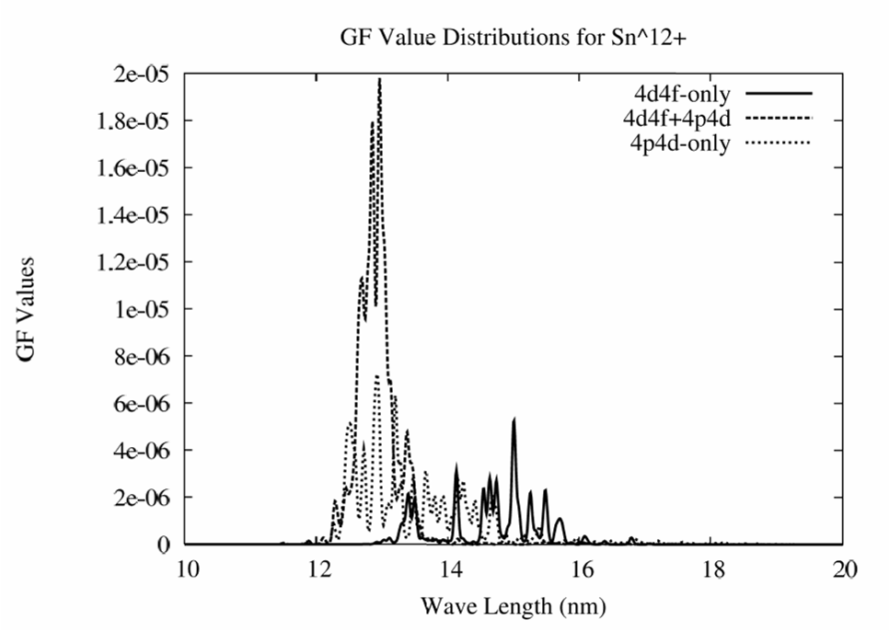
4d-4f & 4p-4d Transitions of
Sn¹²⁺ Ions
A-coefficients of Sn¹²⁺ ions
4d-4f + 4p-4d
Interference considered
CXS Experiments (Tanuma et al TMU)
0.2nm
A-coefficients
4d-4f only
4p-4d only
10 12 14 16 18 20
Wavelength (nm)

Slide 27
Z dependence and CI effects

Slide 28
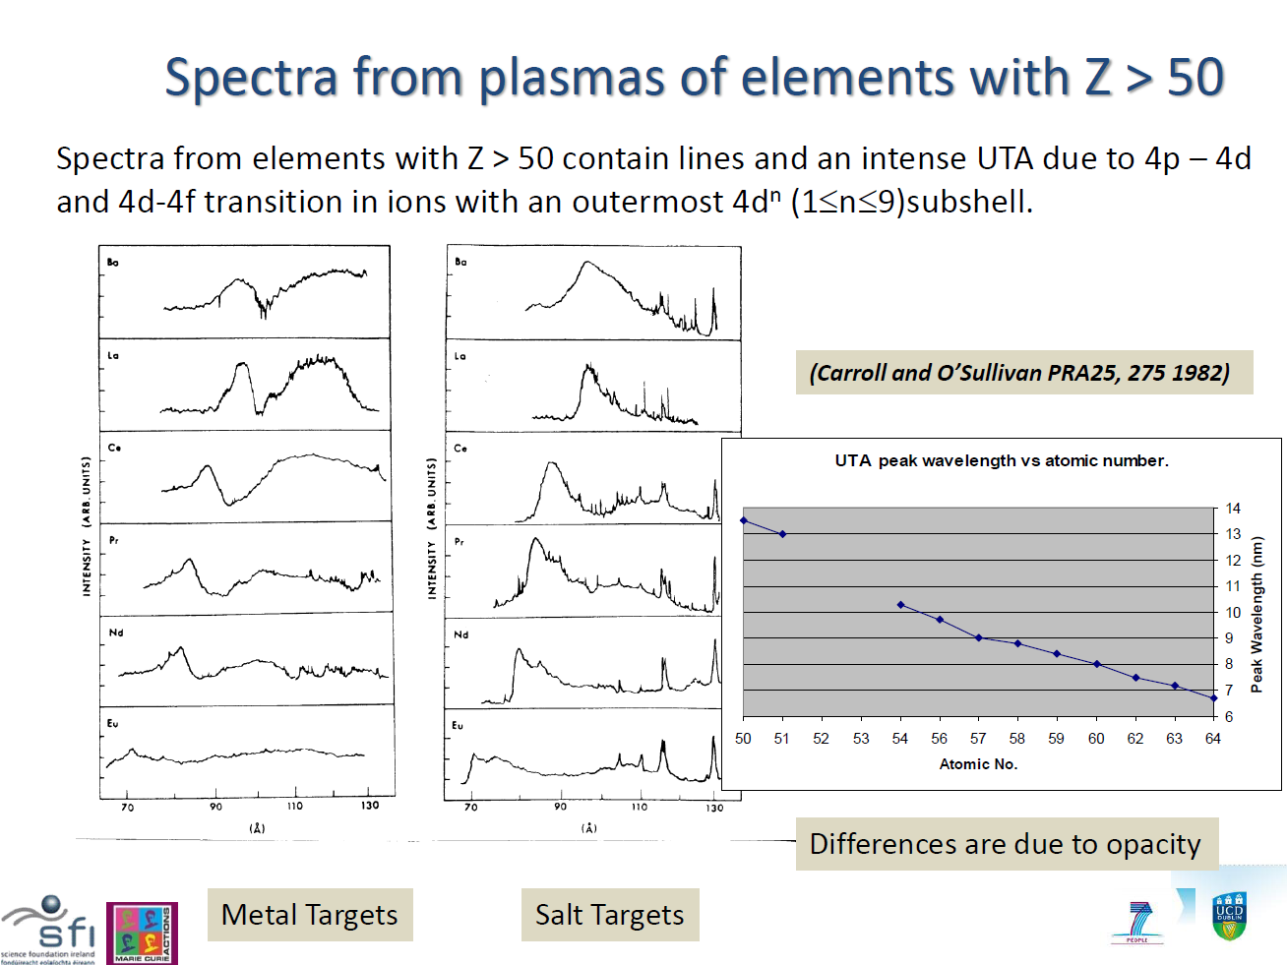
Ba
La
Ce
Pr
Nd
Eu
7 9 11 13 nm 7 9 11 13 nm

Slide 29
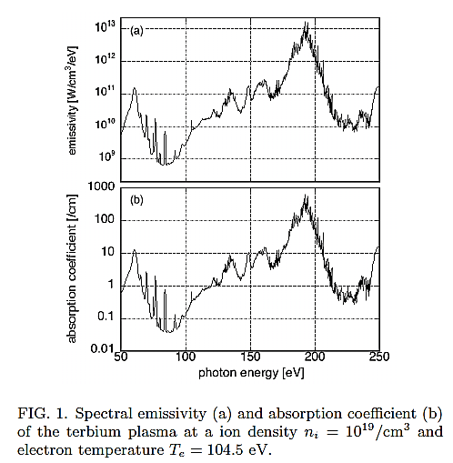
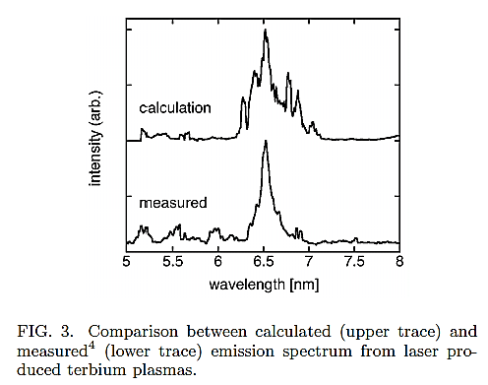
Towards the shorter wavelength: Tb (Terbium, Z = 65 )
Calculation: Sasaki et al (2010), using HULLAC
Experiment: Ref 4: S. S. Churilov, R. R. Kildiyarova, A. N. Ryabtsev, and S. V. Sadovsky, Phys. Scr. 80, 045303 (Oct. 2009).
Sasaki et al, Appl. Phys. Lett. 2010

Slide 30
Outline:
An introductory remark on the development of EUV lithography device
Demands on the knowledge of the emission spectra of atomic ions with Z ~ 50 or more.
The properties of electronic states and transition features in N-open shell atomic ions.
Calculation of many electron highly charged atomic ions
The EUV emission spectra of 13.5 nm or shorter.
Analysis of Gd and Nd spectral lines in LHD plasmas
M1 visible line emission spectra of W ions
Summary

Slide 31
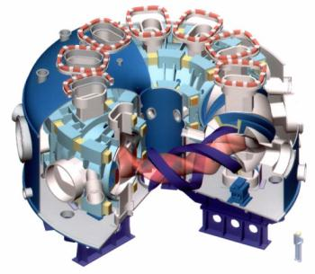
Atomic physics in LHD plasmas
Helical Plasma

Slide 32
Atomic Physics Experiments Using LHD Plasmas
Stable Plasmas of Several keV are Generated in LHD.
Atomic Species will be Ionized to Highly
Charged Stages if Thrown into the High Temperature LHD Plasmas.
Light Emissions are Observed Ranging from Visible to X-ray Regions.
Effect of Many-Electron Interactions may be Observable.

Slide 33
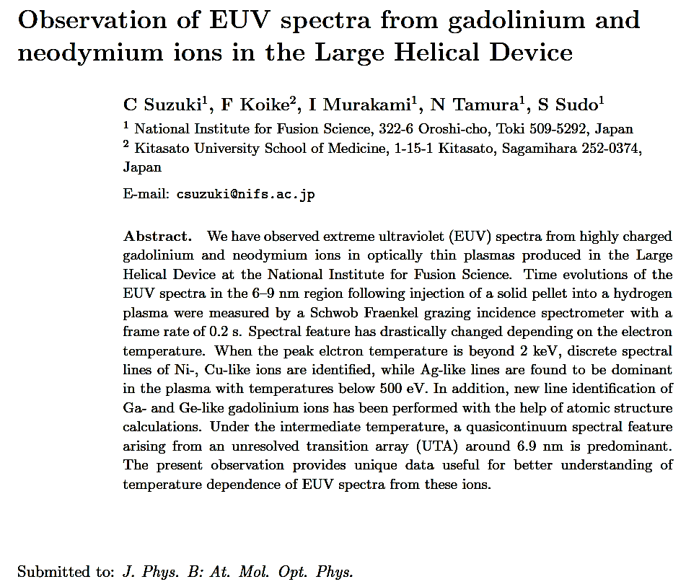
C. Suzuki et al, J. Phys. B 2012

Slide 34
Gd (Gadolinium, Z=64) EUV spectra for different electron temperature
EUV photoemission spectra of Gd ions
for 6.0 – 9.0 nm region
in LHD plasmas
Te = 2.0 keV
Te = 0.24 keV
Te = 1.0 keV
Line Spectrum

Slide 35
Identification of emission lines
Wave Length (nm) （LHD exp.) | Wave Length （Calc.） | Ion | Transition | Values in Literature
7.279 | 7.268 7.168 | Gd XXXIII (Ge-like) | 4s²4p²₂ – 4s²4p4d₁
 | 7.279 7.288 | Gd XXXIV (Ga-like) | 4s²4p_{1/2} – 4s²4d _{3/2} | 7.41(E) 7.326(T) | [1]
7.411 | 7.406 7.411 | Gd XXXV (Zn-like) | 4s4p₁-4s4d₂
7.527 | 7.522 7.528 | Gd XXXVI (Cu-like) | 4p_{1/2}-4d_{3/2} | 7.5259(E) | [2]
7.586 | (7.586) | ?
Black: Atomic Data by HULLAC code and Spectral Analysis by CR model
Green: Atomic Data by GRASP code
[1] Fournier et al. Phys. Rev. A, 50 (1994) 2248: TEXT tokamak
[2] Doschek et al. J. Opt. Soc. Am. B, 5 (1988) 243: laser induced plasmas

Slide 36
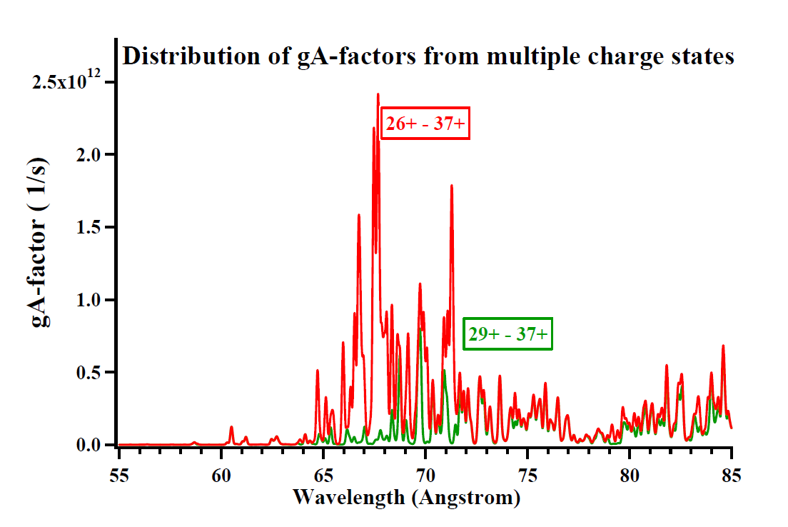
Synthesized Gd Emission Spectra

Slide 37
Exchange interactions between inter- or intra- subshells
|I(4d4p)| < |I(4p4p)|
4d
4p

Slide 38
Gd EUV Spectra for Different Electron Temperature
EUV photoemission spectra of Gd ions
for 6.0 – 9.0 nm region
in LHD plasmas
Te = 2.0 keV
Te = 0.24 keV
Te = 1.0 keV

Slide 39
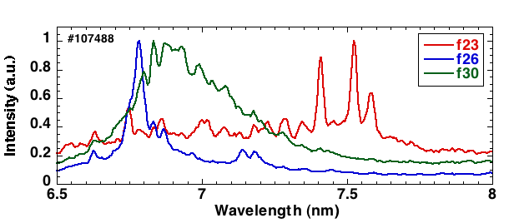
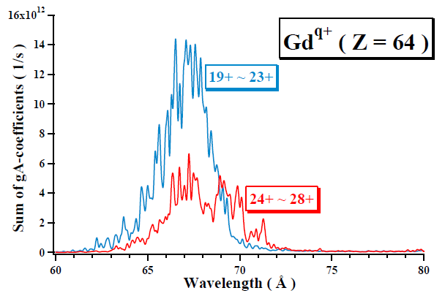
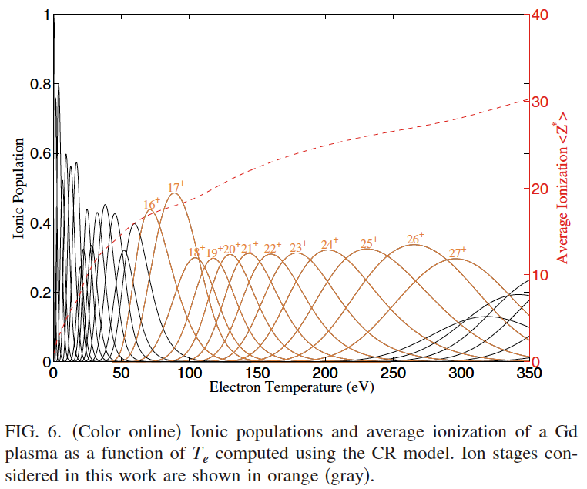
gA-distributions for Gd ions
LHD Experiment
Te = 2.0 keV
Te = 1.0 keV
Te = 0.24 keV
GRASP & RATIP Calculation
25+

Slide 40
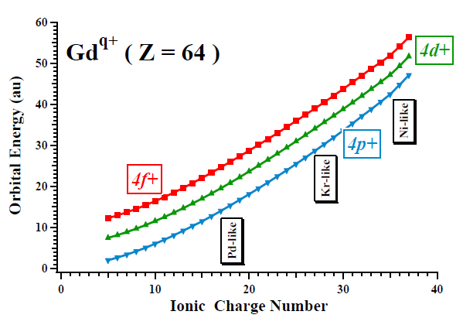
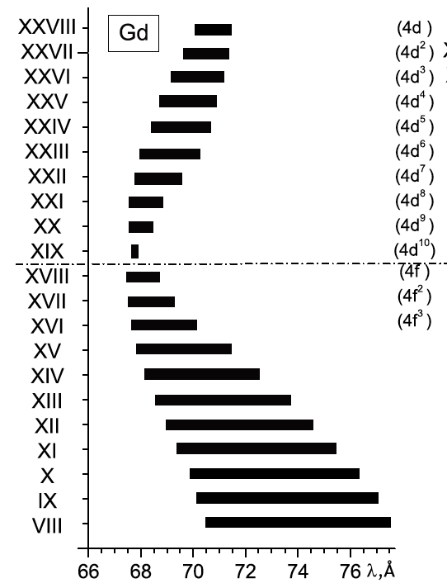
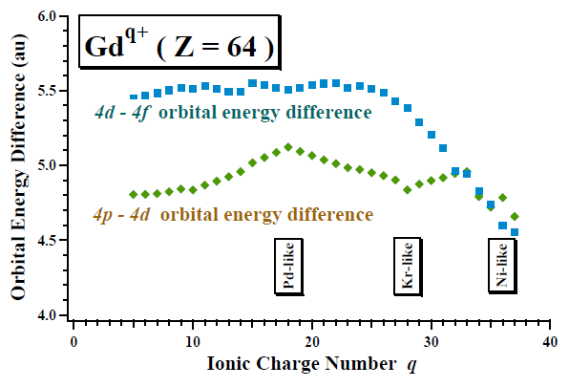
Orbital property of Gd^{q+} ions
Energy difference
Energy difference

Slide 41
Nd (Neodymium) EUV spectra for different electron temperature
EUV Emission Spectra of Nd ions for 6.0－9.0 nm range in LHD plasmas
upper : Te=1.9keV
middle : Te=0.35keV
lower : Te=1.2keV

Slide 42
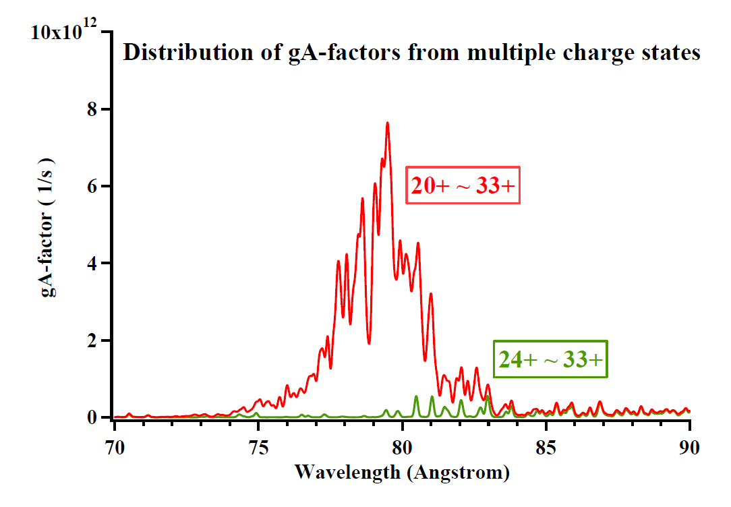
Synthesized gA-distribution of Nd Ions

Slide 43
Outline:
An introductory remark on the development of EUV lithography device
Demands on the knowledge of the emission spectra of atomic ions with Z ~ 50 or more.
The properties of electronic states and transition features in N-open shell atomic ions.
Calculation of many electron highly charged atomic ions
The EUV emission spectra of 13.5 nm regime.
Analysis of Gd and Nd spectral lines in LHD plasmas
M1 visible line emission spectra of W ions
Summary

Slide 44
Magnetic dipole (M1) lines in tungsten (W) highly charged ions
In tungsten highly charged ions with open valence sub-shells, the fine structure splitting comes into the range of visible light emissions.
Magnetic dipole (M1) resonance transitions are available between the ground state fine structure multiplets.
Visible lines are of the great advantage for the purpose of plasma diagnostics because of their ease of the spectroscopic measurement.
M1 lines are expected to suffer less radiation trapping effects from the surrounding ions.

Slide 45
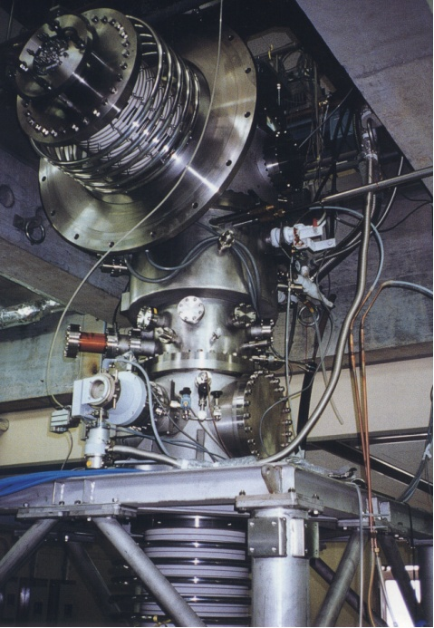
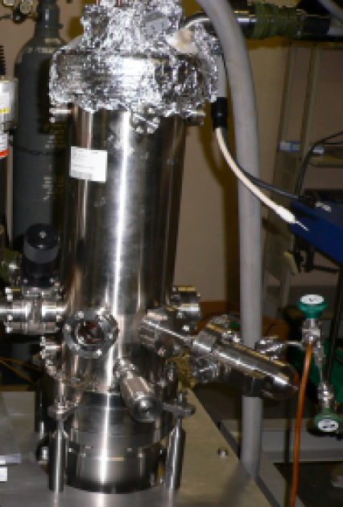
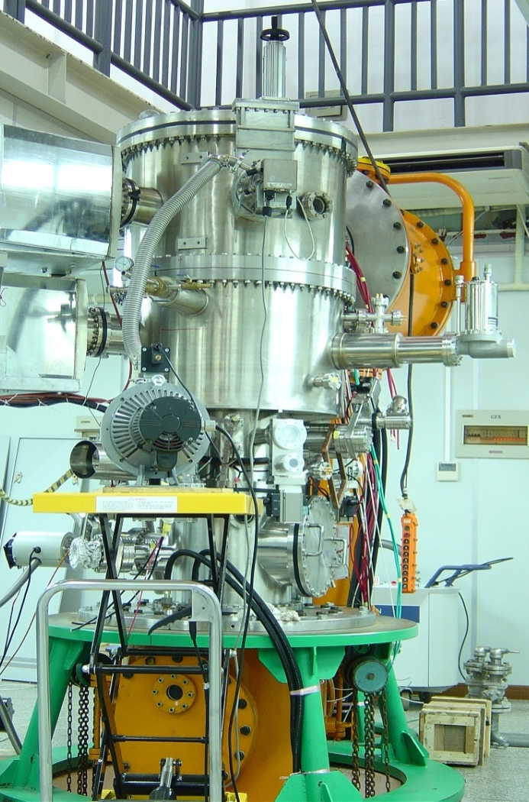
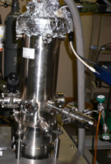
Light Emission from EBIT
Real Size
Tokoy-EBIT
Co-EBIT
Shanghai-EBIT
A. Selective production of ions; B. Narrow ion distribution; C. Long confinement for observation
Notes:
In order to investigate the properties of highly charged W ions, EBIT can be used to create, trap and probe highly charged ions with tightly focused and energy-tunable electron beam. It can produce some ions in certain ionization stage by adjust the incident electron beam energy. And the electron beam is approximate mono-energy. It can be expected that the production ions will be in a narrow ion distributions. After the generation, the ions has been trap in the chamber for a relative long time. It is possible to observe the atomic process.
45

Slide 46
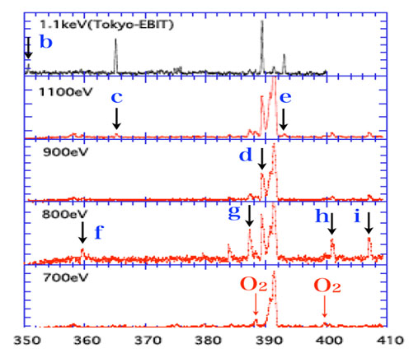
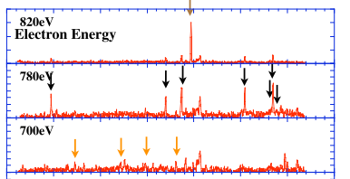

Spectrum of W²⁶⁺ ions
d: 3894
Generation Energy in eV
W³⁰⁺ | 1137 | W²⁶⁺ | 786.3
W²⁹⁺ | 887 | W²⁵⁺ | 738.6
d (3894Å) : From W²⁶⁺

Slide 47
The first step to the calculation of tungsten ion M1 transitions
W ²⁶⁺ : [Kr]4f² = …4s²4p⁶4d¹⁰4f²
The simplest ion that have multiple
4f orbital electrons.
Atomic ground state has less difficulties for
variational calculation.
A large scale MCDF calculation is feasible.

Slide 48
Correlation Models for W²⁶⁺ Ground State Energy Levels
  Active Space:
    AS={4f,5s,5p,5d,5f,5g}
  Valence-Valence Correlation:
    5SD: 4d¹⁰4f² -> 4d¹⁰(AS)²
  Core-Valence Correlation:
    4p_5SD: 4s²4p⁶4d¹⁰4f² -> 4s²4p⁵4d¹⁰4f¹(AS)²
  Core-Core Correlation:
    4p_5SD: 4s²4p⁶4d¹⁰4f² -> 4s²4p⁵4d¹⁰4f¹(AS)²
Active Space
4f,
n = 5, 6,7
Valence:
4f
Core:
4s, 4p, 4d
Valence excitation
Core excitation
Valence-Valence correlation
Inactive Core
1s, 2s, 2p,
3s, 3p, 3d
Core-Valence correlation
Core-Core correlation

Slide 49
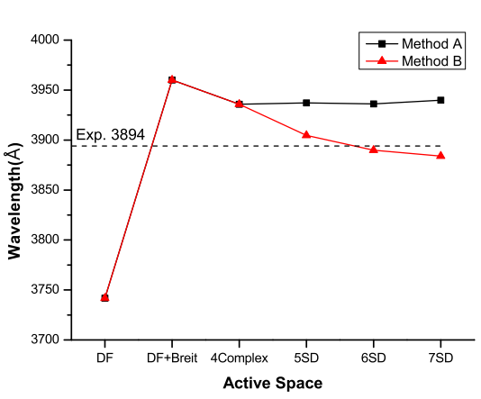
Convergence feature in the wavelength of W²⁶⁺ ³H₅ - ³H₄ M1 transitions
3936
With VV and CV correlations
With VV, CV, and CC correlations
3884
transition: [4f-²]₄ - [[4f-]_{5/2}[4f]_{7/2}]₅

Slide 50
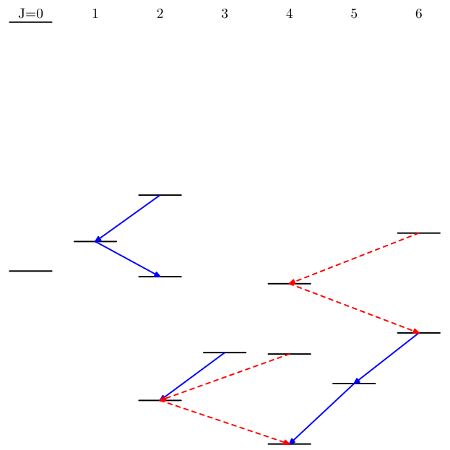
Possible visible transitions between the W²⁶⁺ ground state multiplets
Tran | Wavelength(Å) | Type | A_{ij}(s⁻¹) | gf
³H₅ →³H₄ | 3884.34 | M1 | 3.94(2) | 9.80(-6)
 |  | E2 | 1.69(-3) | 4.21(-11)
³H₆→³H₅ | 4677.96 | M1 | 2.05(2) | 8.75(-6)
 |  | E2 | 3.31(-4) | 1.41(-11)
¹I₆→³F₄ | 4721.59 | M1 | 2.90(-2) | 1.26(-9)
³F₄→³H₆ | 4826.63 | E2 | 6.36(-4) | 2.00(-11)
³F₃→³F₂ | 5017.99 | M1 | 1.75(2) | 4.62(-6)
 |  | E2 | 7.28(-5) | 1.92(-12)
¹G₄→³F₂ | 5090.88 | M1 | 1.82(-4) | 6.37(-12)
³P₂→³P₁ | 5160.06 | M1 | 6.43(1) | 1.28(-6)
 |  | E2 | 6.65(-4) | 1.33(-11)
³F₂→³H₄ | 5366.71 | M1 | 7.33(-3) | 1.58(-10)
³P₁→¹D₂ | 6851.63 | M1 | 2.33(1) | 4.93(-7)
 |  | E2 | 9.59(-6) | 2.03(-13)
¹S
³P
5160
¹I
³P
4721
³P
6851
¹D
³F
4826
³H
³F
¹G
4677
5017
5090
³H
³F
3884
3894
5366
³H

Slide 51
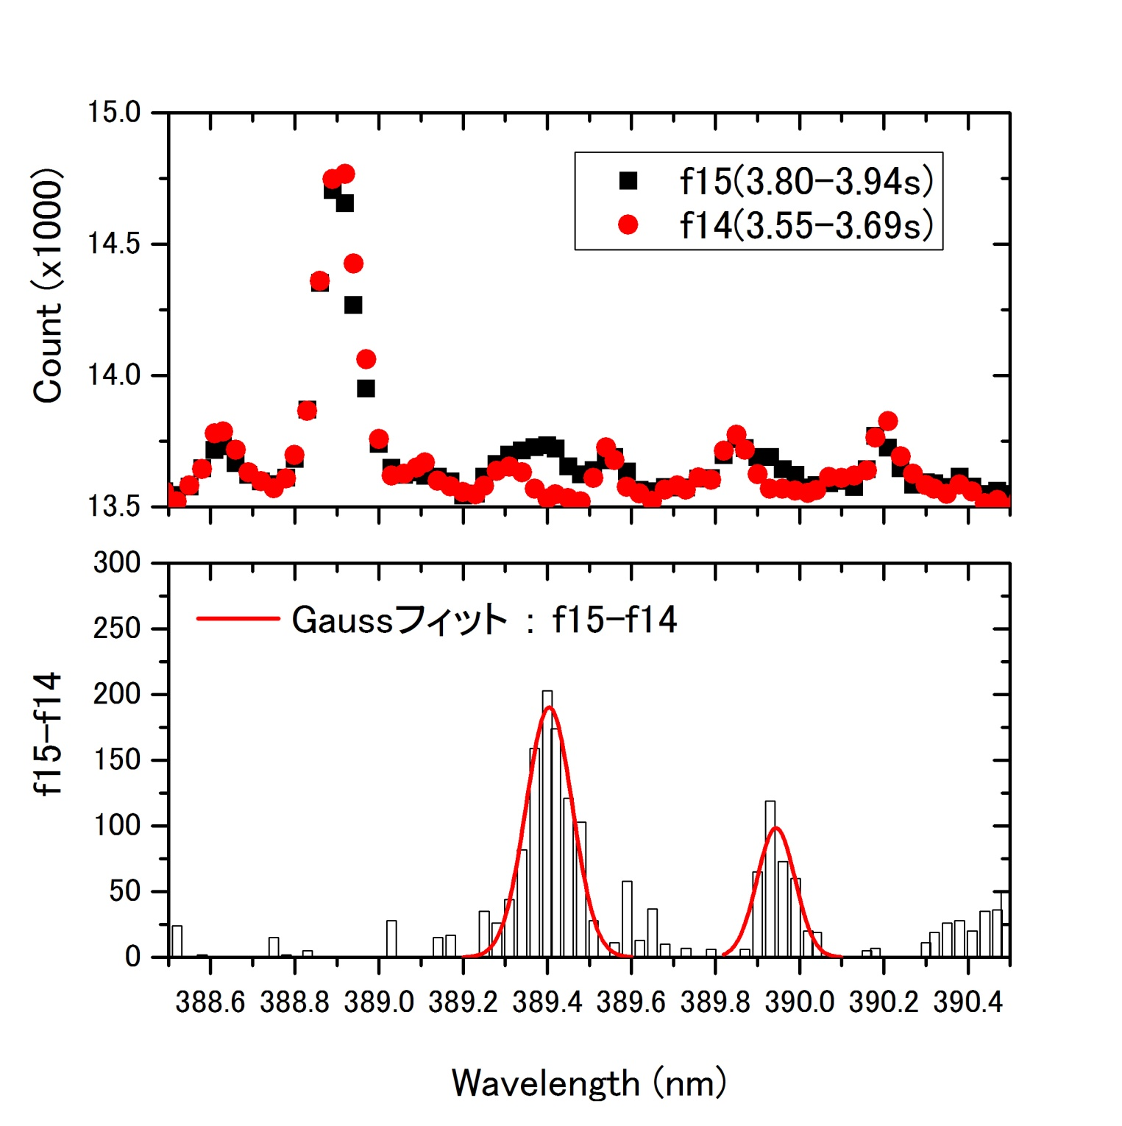
He I 388.86/H I 388.91
Instrumental: 0.045nm
fitting
389.943(7)
389.404(6)
W^{q+}?
2012/3/14
51

Slide 52
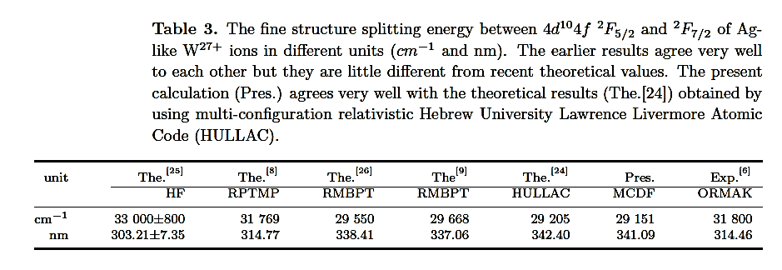
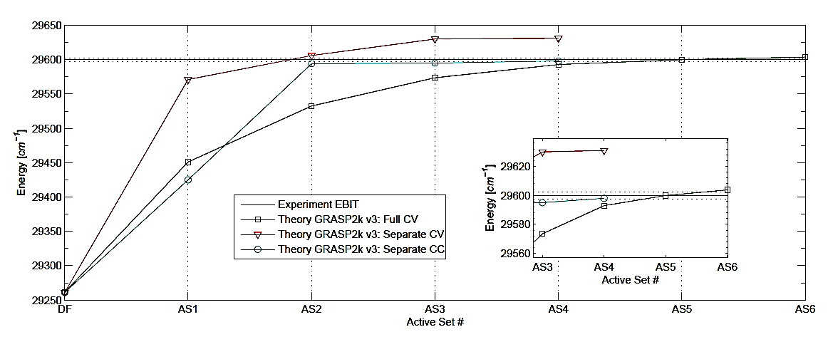
Shanghai PermEBIT experiment and GRASP2K calculation
Experimental:
3378.4 Å or 29 599 ± 2.28 cm⁻¹
Theory by J. Grumer et al:
3378 Å or 29 603 cm⁻¹
Previous theory by X. Ding et al,
2012 J. Phys. B. 45 035003:
341.09 nm or 29151 cm⁻¹
Experiment: Z. Fei, R. Zhao, et al, Accepted by Phys. Rev. A (2012).
Theory: J. Grumer and T. Brage, In preparation (2012), see also poster 3a-Mon
GRASP2K: P. Jönsson, G. Gaigalas et al, Comput. Phys. Commun. To be submitted (2012).

Slide 53
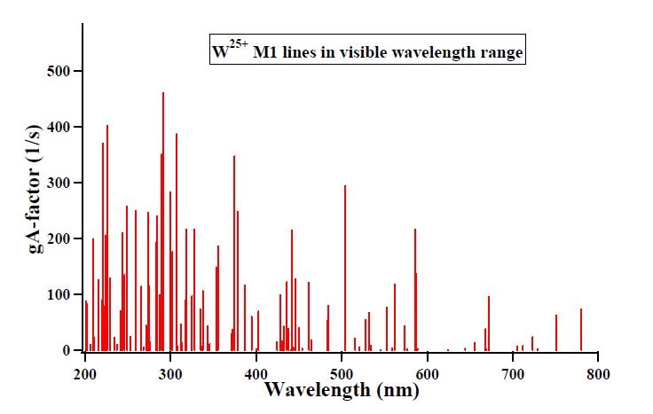
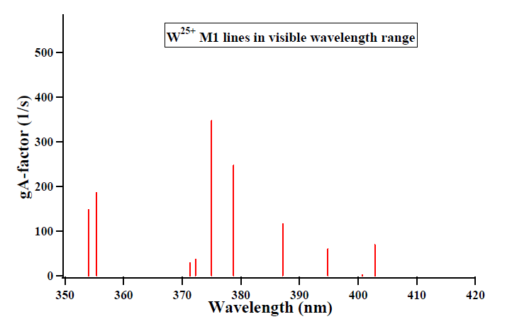
25+, 387.1 nm
J = 7/2 – 7/2

Slide 54





W^{(28-n)+} M1 lines of 4f^{n} states with n = 2 ~ 7
4f ⁵
4f ²
4f ³
4f ⁶
4f ⁷
4f ⁴

Slide 55
Summary:
An introductory remark on the development of EUV lithography device has been given.
Demands on the knowledge of the emission spectra of atomic ions with Z ~ 50 or more have been discussed in relation to the spectral narrowing and shifts that appears in N-open shell atomic ions.
The properties of electronic states and transition features in N-open shell atomic ions are discussed.
GRASP + RATIP calculation has been introduced in relation to the basics of the variational principle.
The EUV emission spectra of 13.5 nm have been discussed and some efforts towards the shorter wavelength regime have been introduced.
Analysis of Gd and Nd spectral lines in LHD plasmas has been made in detail.
M1 visible line emission spectra of W ions are discussed and GRASP+RATIP calculation have been discussed

Slide 56
Thank You

