Slide 1
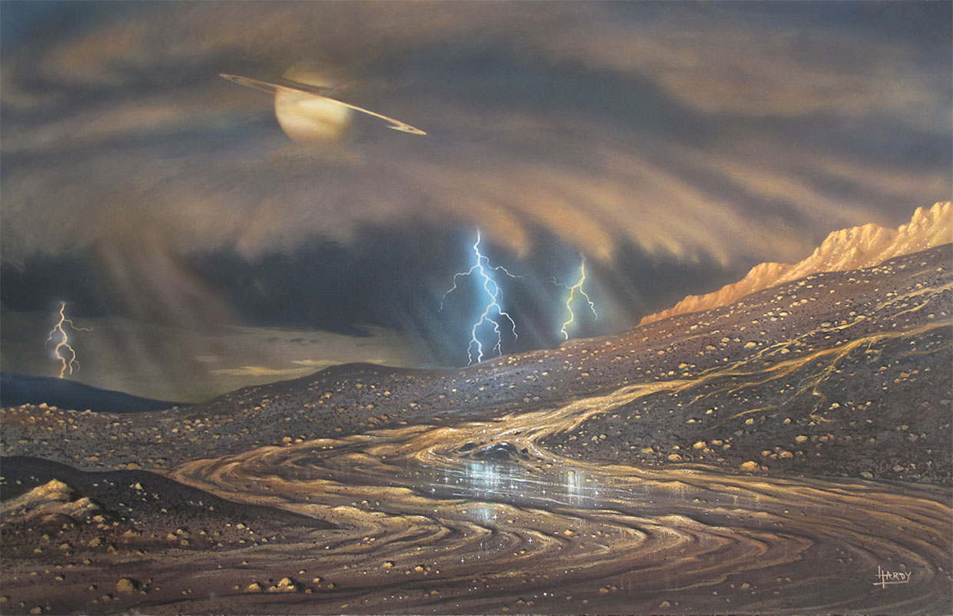
The HITRAN Molecular Database
Laurence S. Rothman
Iouli E. Gordon
Atomic & Molecular Physics Division
Harvard-Smithsonian Center for Astrophysics
ICAMDATA-8
1-4 October 2012

Slide 2
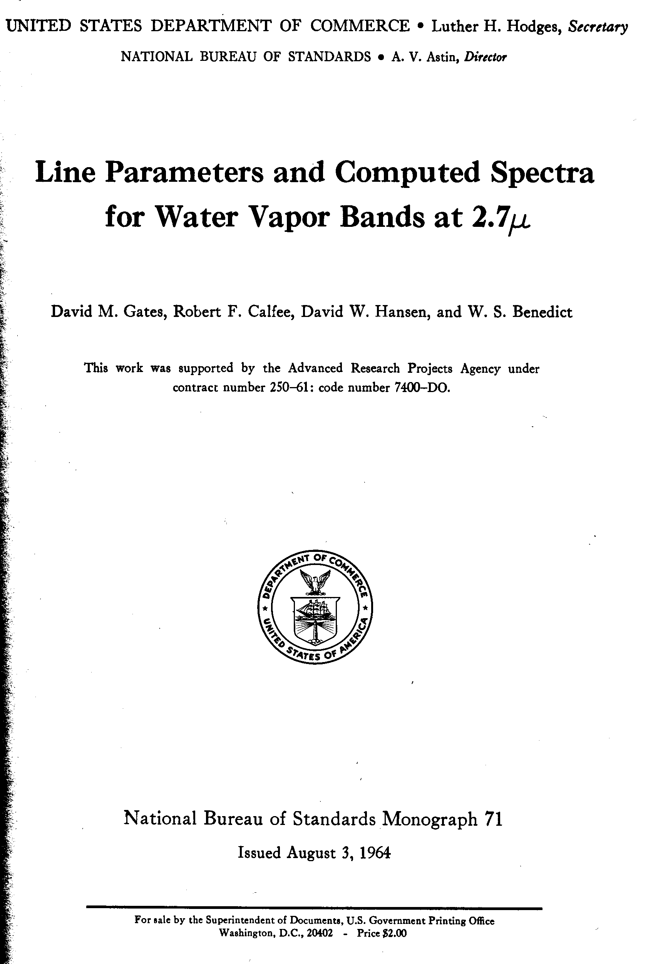
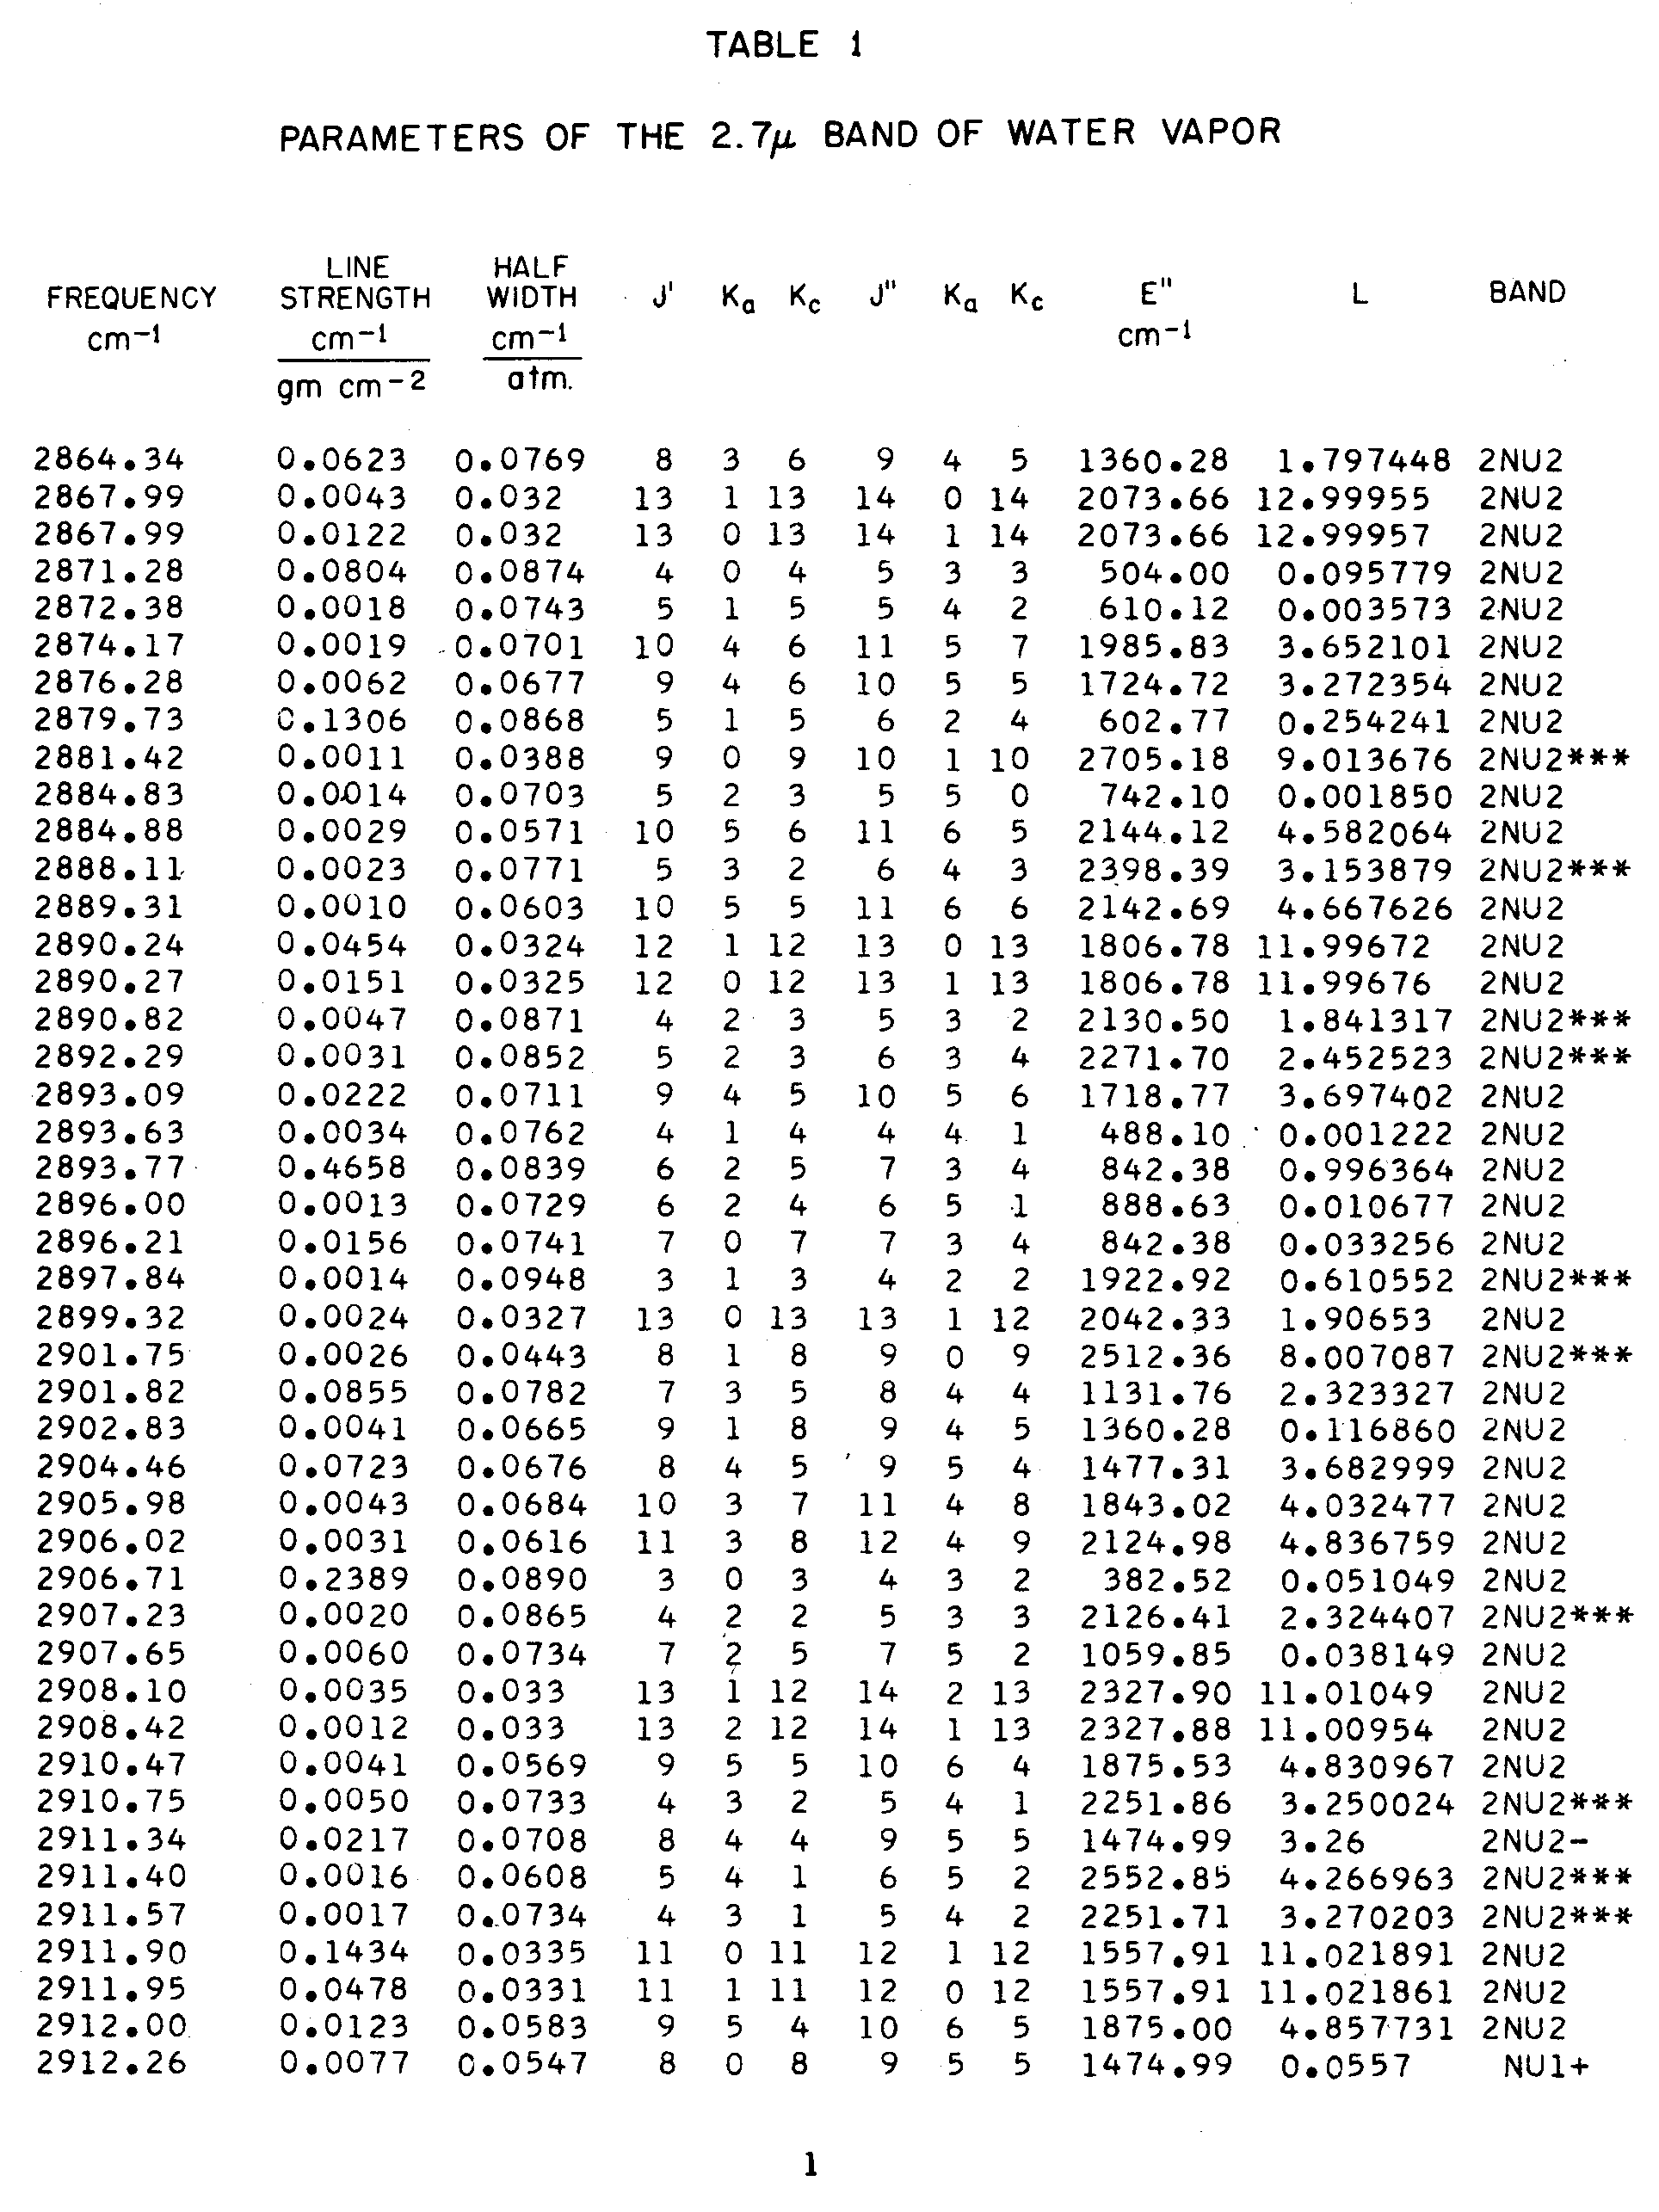
Proto-HITRAN

Slide 3
File Structure of HITRAN Compilation
Level 1
JavaHAWKS Software Installers and Documentation
HITRAN
(line-transition parameters)
IR
Cross-sections
UV
Aerosol
Refractive Indices
Line
Coupling
CO₂ data
Level 2
Global Data Files, Tables, and References
Molecule-
by-molecule
Line-by-line
Cross-sections
Supplemental
Supplemental
Alternate
Level 3

Slide 4
HITRAN Line-by-line Parameters
Parameter | Field size | Definition
Mol | I2 | Molecule number
Iso | I1 | Isotopologue no.(1 = most abundant, 2 = second most abundant, …)
ν_{if} | F12.6 | Transition wavenumber in vacuum [cm⁻¹]
S_{if} | E10.3 | Intensity [cm⁻¹/(molecule∙cm⁻²) @ 296K]
A_{if} | E10.3 | Einstein A-coefficient [s⁻¹]
γ_{air} | F5.4 | Air-broadened half-width (HWHM) [cm⁻¹/atm @ 296K]
γ_{self} | F5.4 | Self-broadened half-width (HWHM) [cm⁻¹/atm @ 296K]
E″ | F10.4 | Lower-state energy [cm⁻¹]
n_{air} | F4.2 | Temperature-dependence coefficient of γ_{air}
δ_{air} | F8.6 | Air pressure-induced shift [cm⁻¹/atm @ 296K]
v′, v″ | 2A15 | Upper and Lower “global” quanta
q′, q″ | 2A15 | Upper and Lower “local” quanta
ierr | 6I1 | Uncertainty indices for ν_{if} , S_{if} , γ_{air} , γ_{self} , n_{air} , δ_{air}
iref | 6I2 | Reference pointers for ν_{if} , S_{if} , γ_{air} , γ_{self} , n_{air} , δ_{air}
* | A1 | Flag for line-coupling algorithm
g′, g″ | 2F7.1 | Upper and Lower statistical weights
160-character total

Slide 5
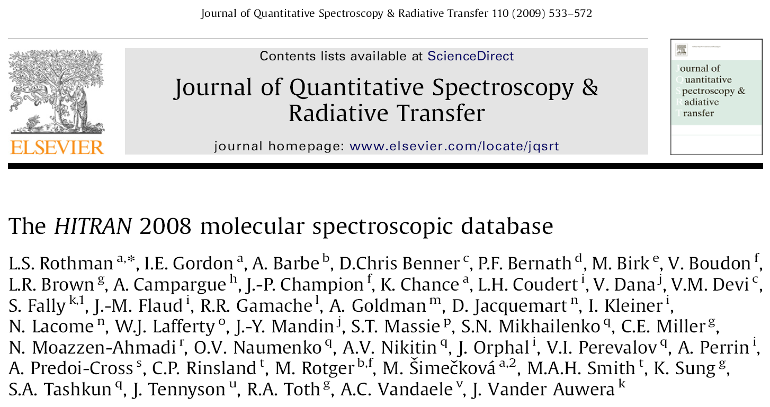
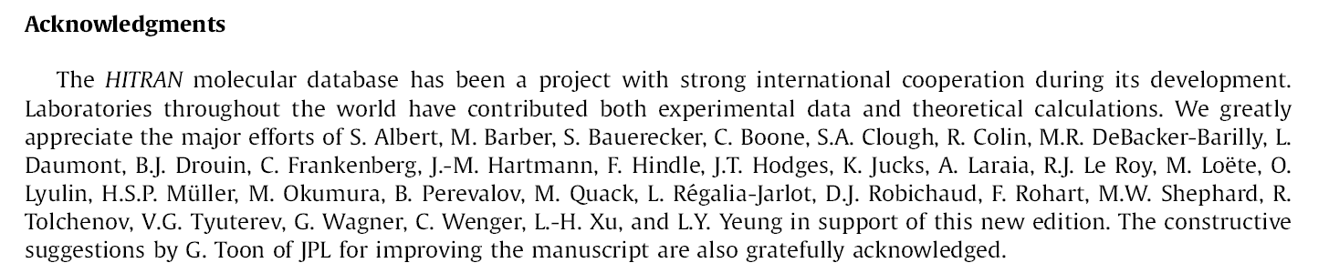

Slide 6
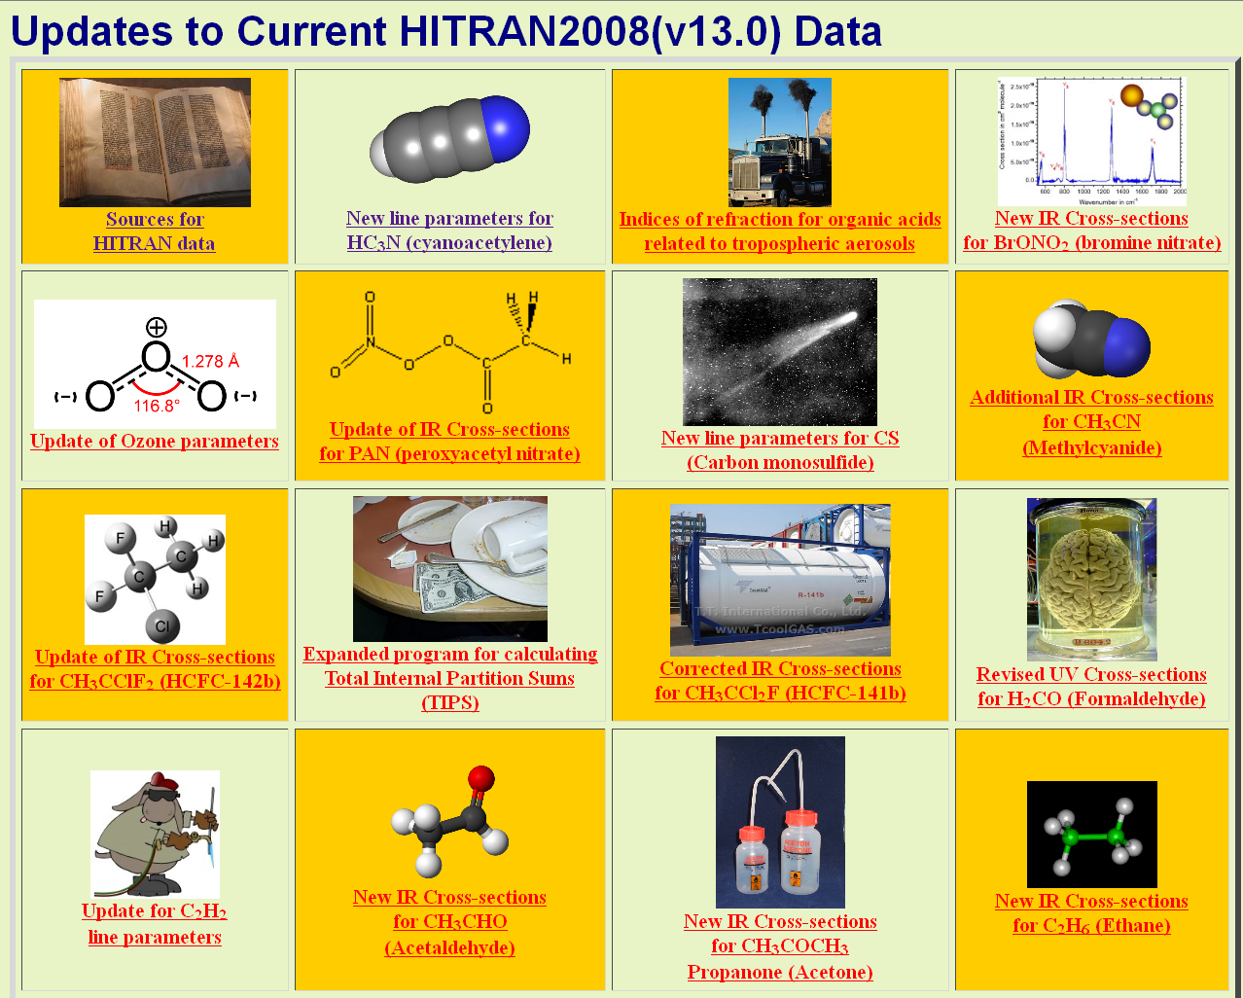

Slide 7
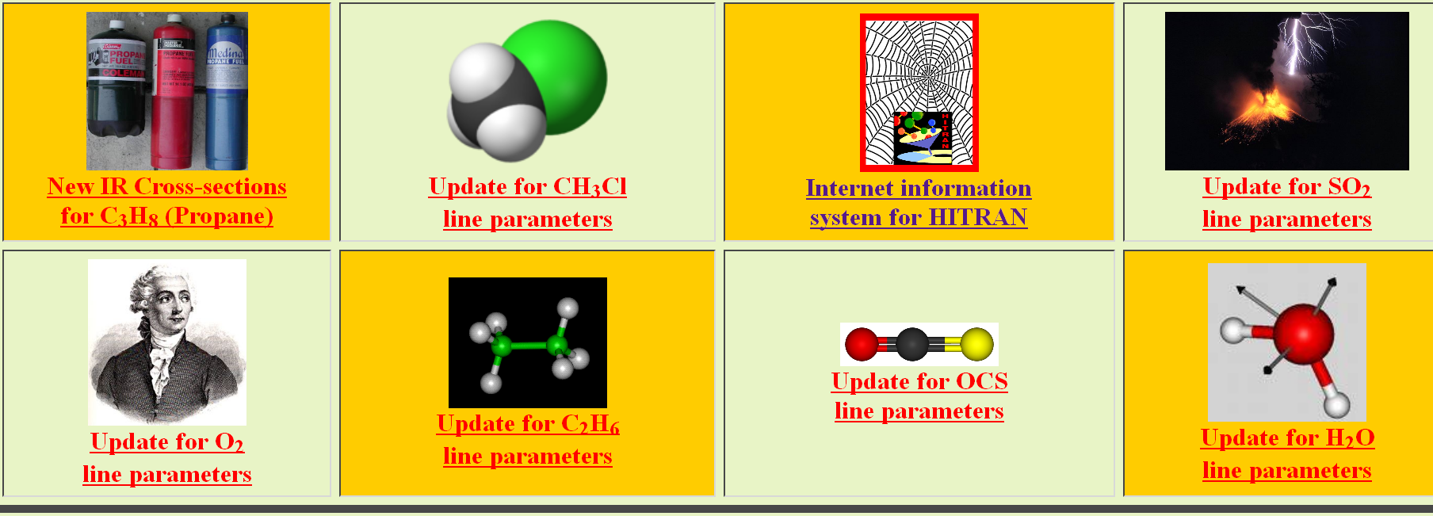
Updates to HITRAN2008 data
(continued)

Slide 8
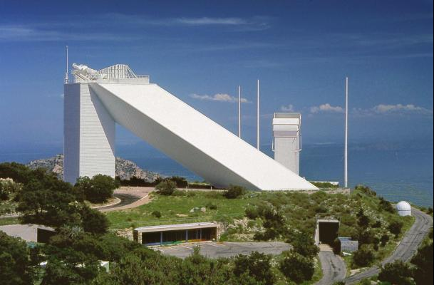
Kitt Peak National Solar Observatory
(near Tucson Arizona)

Slide 9
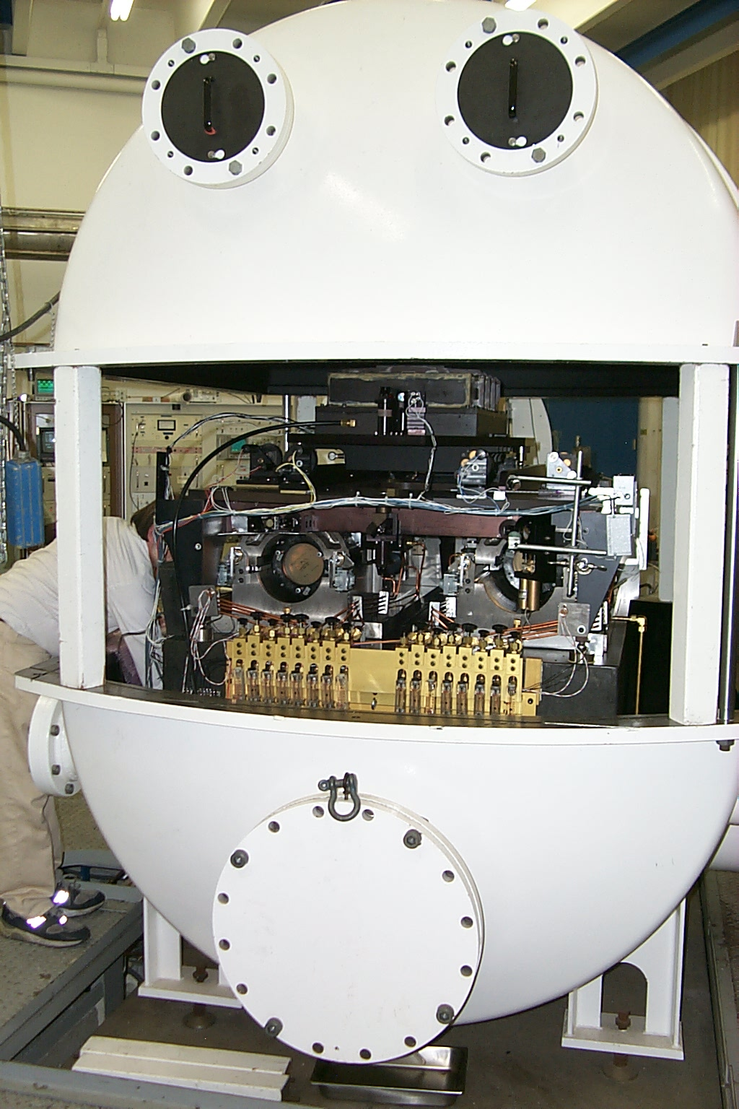
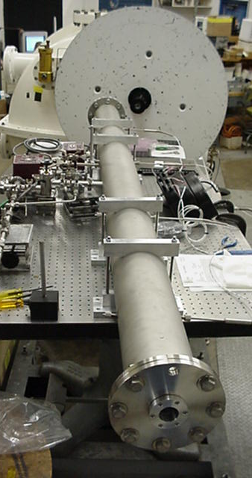
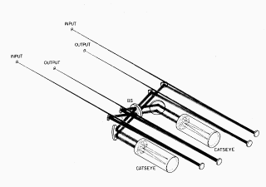
Fourier Transform Spectrometer
Absorption Cell

Slide 10
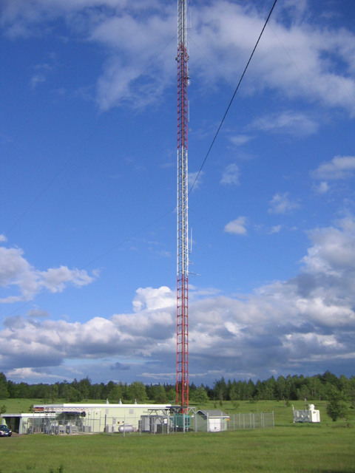
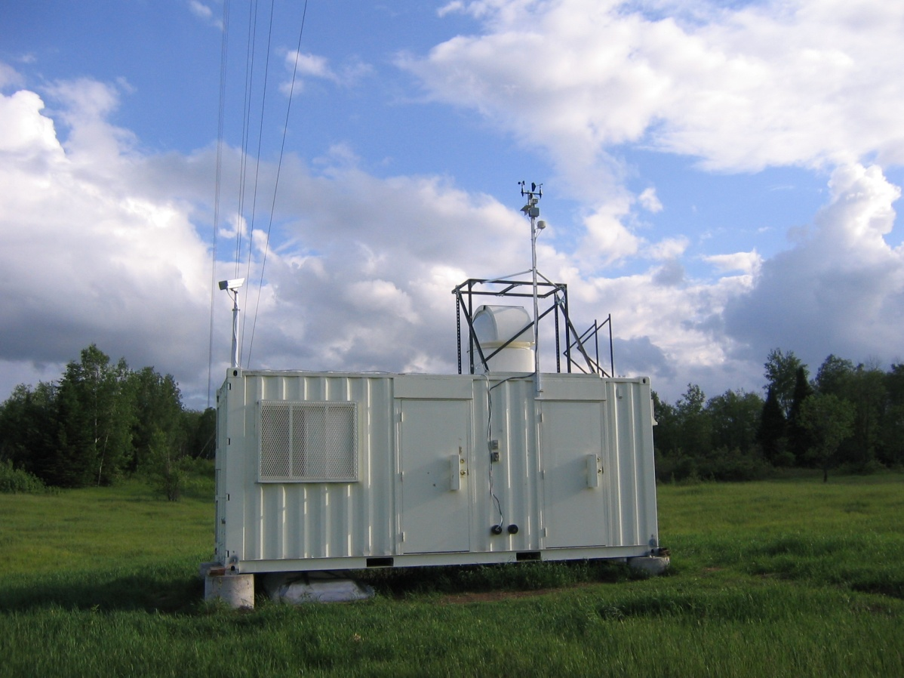
FTS near Tall Tower in Park Falls WI
447-m WLEF tower
Total Column Carbon Observing Network (TCCON)

Slide 11
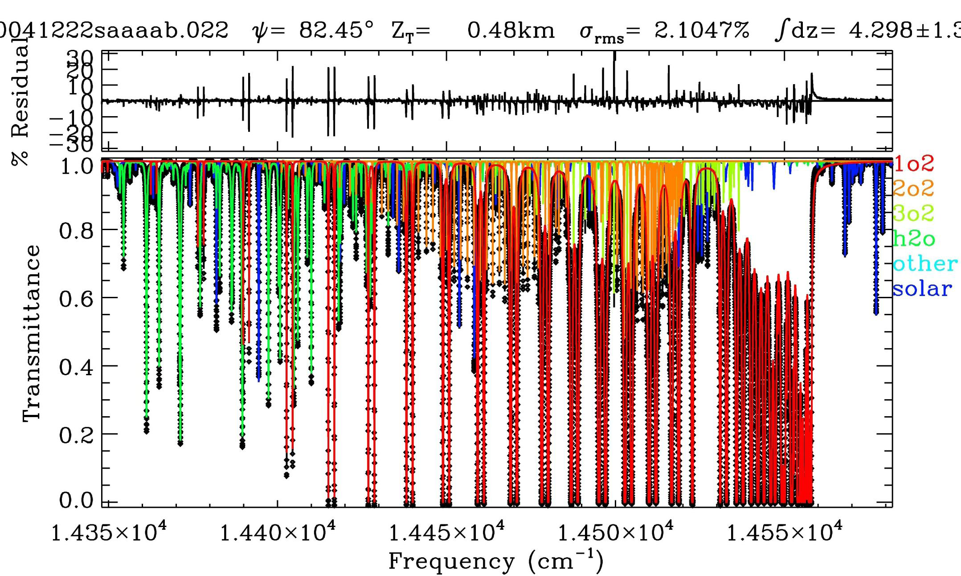
Comparison between HITRAN and Ground-based FTS observations for Oxygen B-band
Experiment by G. Toon,
at Wisconsin tower site

Slide 12
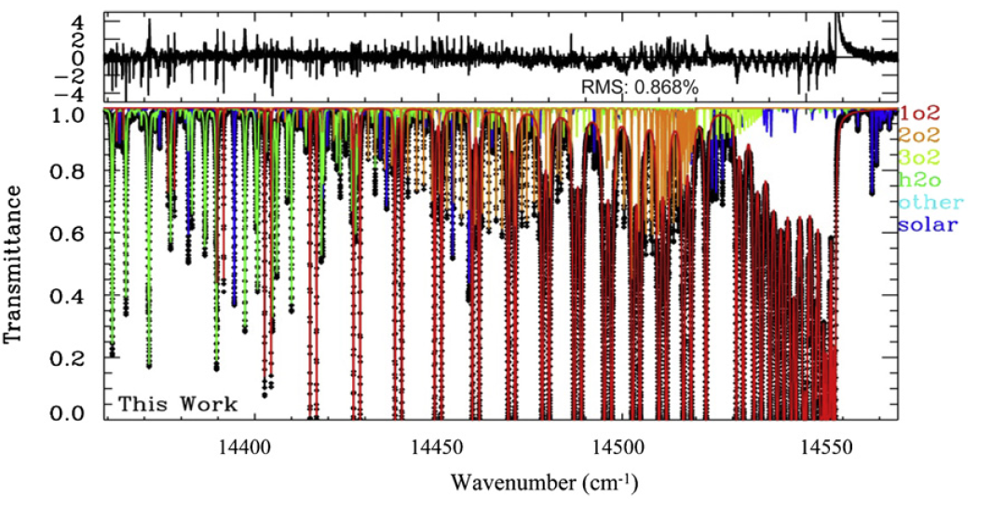
Comparison between New Analysis and Ground-based FTS observations for Oxygen B-band

Slide 13
Spectroscopic parameters of the v = 1 and 2 levels
of the b¹Σ_{g}⁺ state of ¹⁶O₂
Parameter (cm⁻¹) | This work | Albritton et al ª | Cheah et al ^{b} | Phillips et al ^{c} | Naus et al ^{d}
T₁ | 14526.9896(12) | 14526.9909(17) | 14525.65553(26) | 14526.9976(12)
B₁ | 1.3729553(72) | 1.372982(10) | 1.3729659(22) | 1.372951(18)
D₁ | 5.3960(93) ×10⁻⁶ | 5.418(10) ×10⁻⁶ | 5.4086(42) ×10⁻⁶ | 5.397(50) ×10⁻⁶
T₂ | 15903.7479(27) | 15903.7509(16) | 15902.4251(32) |  | 15903.748(3)
B₂ | 1.354630(23) | 1.354609(11) | 1.354644(38) |  | 1.35463(2)
D₂ | 5.484(36) ×10⁻⁶
Number of lines used in this work per band |  | MW: 85; Raman: 94; b¹Σ_{g}+ (v=1) − a¹Δ_{g}(v=0): 29; a¹Δ_{g} − X ³Σ_{g}− : 199; b¹Σ_{g}+ (v=1) − X ³Σ_{g}− (v=0): 72; b¹Σ_{g}+ (v=2) − X ³Σ_{g}− (v=0): 49
a. Albritton DL, Harrop WJ, Schmeltekopf AL, Zare RN, J Mol Spectrosc 1973;46:103-18
b. Cheah S-L, Lee Y-P, Ogilvie JF, JQSRT 2000;64:467-82
c. Phillips AJ, Peters F, Hamilton PA, J Mol Spectrosc 1997;184:162-6
d. Naus H, Navaian K, Ubachs W, Spectrochimica Acta Part A 1999;55:1255-62

Slide 14
Water Vapor (H₂O)
► Relax intensity cutoff. For lines for which accurate measurements are not available, take the differences in experimentally known energy levels supplemented with ab initio intensities.
► Intensities in the 4500-5000 cm⁻¹ region. Incorporating ab initio calculations of Lodi et al (University College London).
► Intensities in the 8000-9000 cm⁻¹ region. Adopting measurements of Oudot et al, J Mol Spectrosc 262, 22-29 (2010).
► Line-shape parameters. Include new measurements into line shape algorithm; correct the CRB-calculated widths, shifts and temperature dependences of narrow lines as suggested in Ma, Tipping, Gamache, "Uncertainties associated with theoretically calculated N₂-broadened half-widths of H₂O lines," Mol Phys 108, 2225-2252 (2010).
► Assignments of unidentified water lines.

Slide 15
Carbon Dioxide (CO₂)
► Update DND calculations. Replace with validated new experimental values or with CDSD calculations (Institute of Atmospheric Optics, Tomsk).
► Include newest experimental results. For example, work of Perevalov et al, IAO.
► Multispectrum fit. Evaluate applicability of work for OCO-2 (NASA Langley and JPL).
► Line-shape parameters. Change broadening parameters for J > 50 (Lamouroux et al, JQSRT (2012)); Use algorithm developed by Hartmann et al, JQSRT (2009) for unmeasured shifts; extend line-mixing work of Lamouroux et al, JQSRT (2010) to entire carbon-dioxide line list.

Slide 16
Methane (CH₄)
Many, many recent theoretical and experimental works by the groups at Grenoble, Reims, Dijon, JPL, NASA Langley...
► 1.26 - 1.71 µm region. Extensive cavity ring down experiments by Campargue et al (Grenoble).
► 2 µm region. For example, octad region work of Daumont et al (Reims).
► 0.89 µm region. Work of Benner et al, unpublished.
► Deuterated species. Collaboration between University of Burgundy and IAO.
► Line-shape parameters. New broadening parameters by Smith et al, JQSRT (2010 and 2011).

Slide 17
Oxygen (O₂)
► A band. Adapt line lists from work of Long et al, JQSRT (2010 and 2011).
► B-, γ-, and associated hot bands. SAO collaboration with Geoff Toon (JQSRT (2011)).
► Microwave region. Revision of line-shape parameters, Gordon, SAO
► 1.27 µm region. Collaborative effort of SAO, JPL, and Grenoble.

Slide 18
Improvements and Enhancements to the Compilation being considered
►More temperature-pressure sets of cross-sections (IR and UV)
►Improved database structure (VAMDC paradigm)
►High-temperature parameters (HITEMP)
►Molecules for astrophysics applications
►Refined line-shape parameters
►Additional line-mixing algorithms
►Collision-Induced Absorption bands

Slide 19
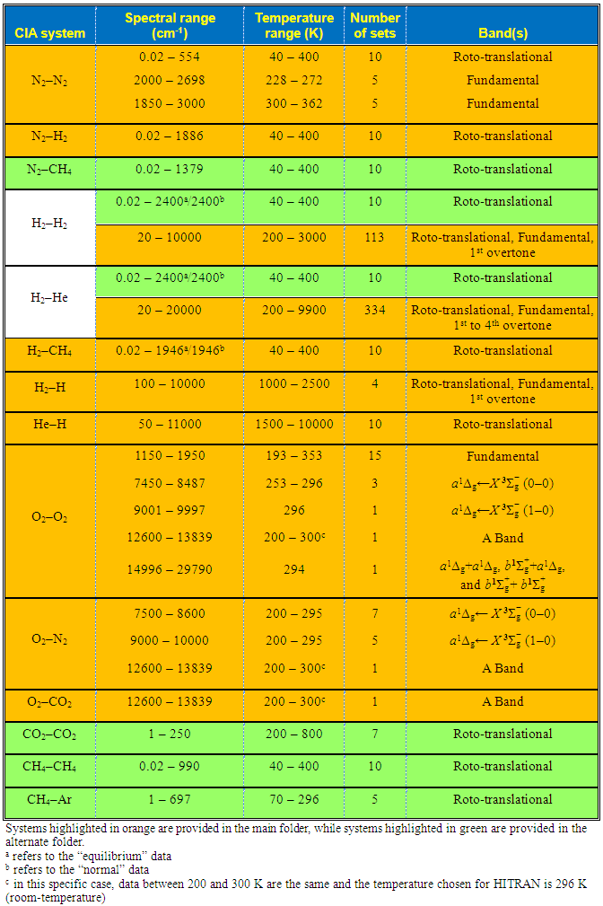
Collision Induced Absorption (CIA)
“New section of the HITRAN database: Collision-Induced Absorption (CIA),” C. Richard, et al, JQSRT 113, 1276-85 (2012).

Slide 20
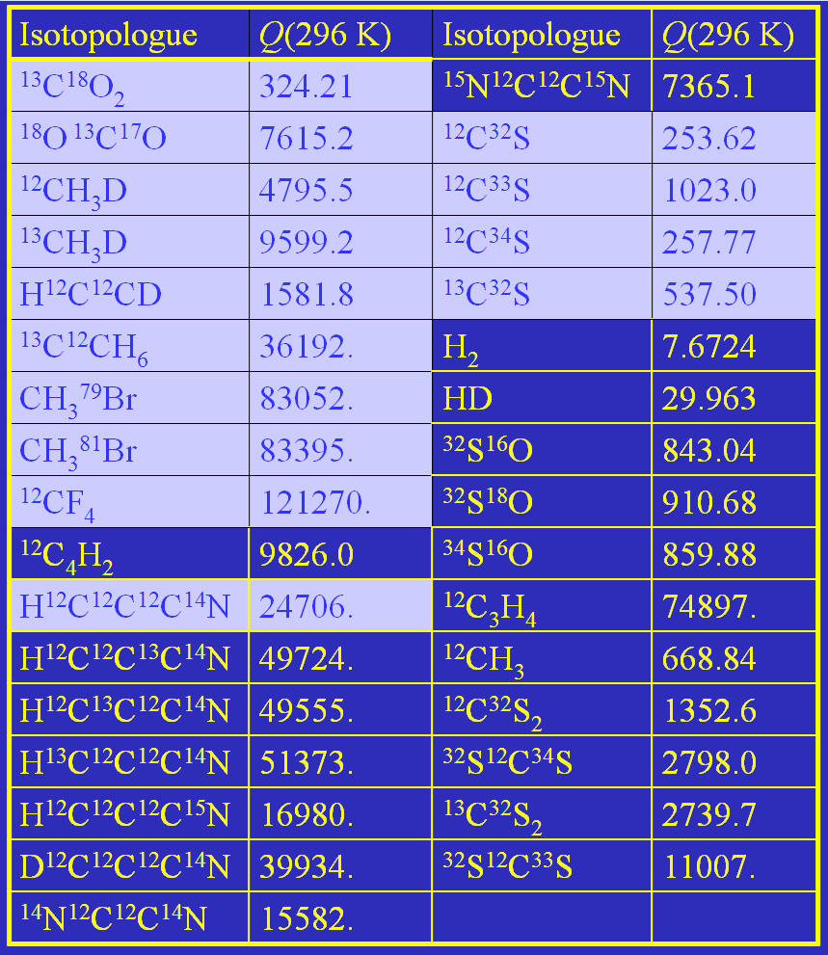
New Molecules Added to HITRAN

Slide 21
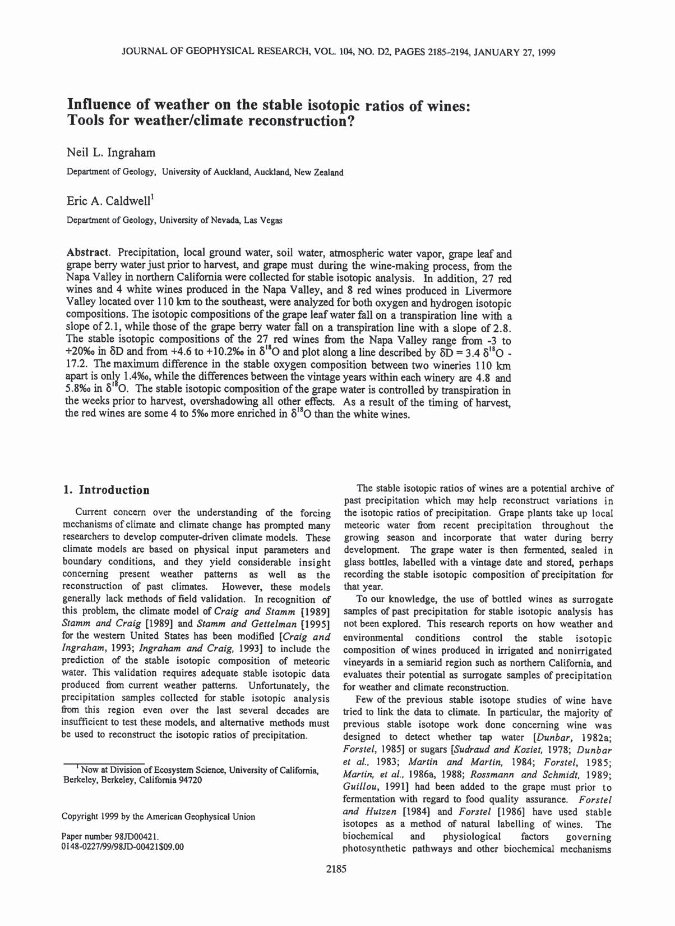

Slide 22

Access
web site:
http://cfa.harvard.edu/HITRAN
Gives instructions for accessing compilation (free)
Updates
- Documentation
- Links to related databases
- HITRAN facts
- Related conferences

Slide 23
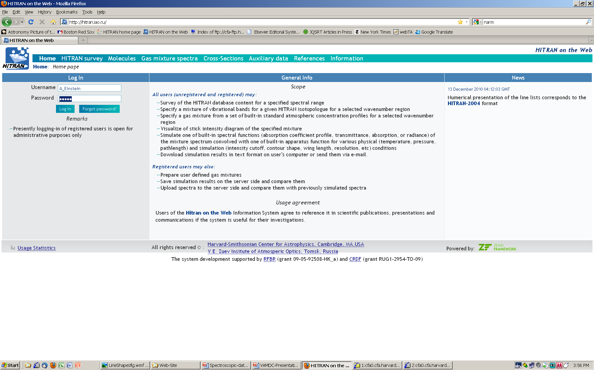

Slide 24
A new format for HITRAN
Relational Database
  To store the data (tables linked by keys)
  SQL to return data (in different formats)
  Easy to extend, maintain, and validate
XSAMS
  XML Schema for Atoms, Molecules, and Solids
  An interoperable standard for the communication of data from different sources
Web interface:
  http://vamdc.mssl.ucl.ac.uk/HITRAN/search

Slide 25



Acknowledgments
SAO HITRAN team members
Kelly Chance
Iouli Gordon
Gang Li
Cyril Richard
Cameron Mackie
Huge International Collaborative Effort
International HITRAN Advisory Committee
Funding Support
NASA Earth Observing System
NASA Planetary Atmospheres Program
Cooperative Research Development Foundation

Slide 26
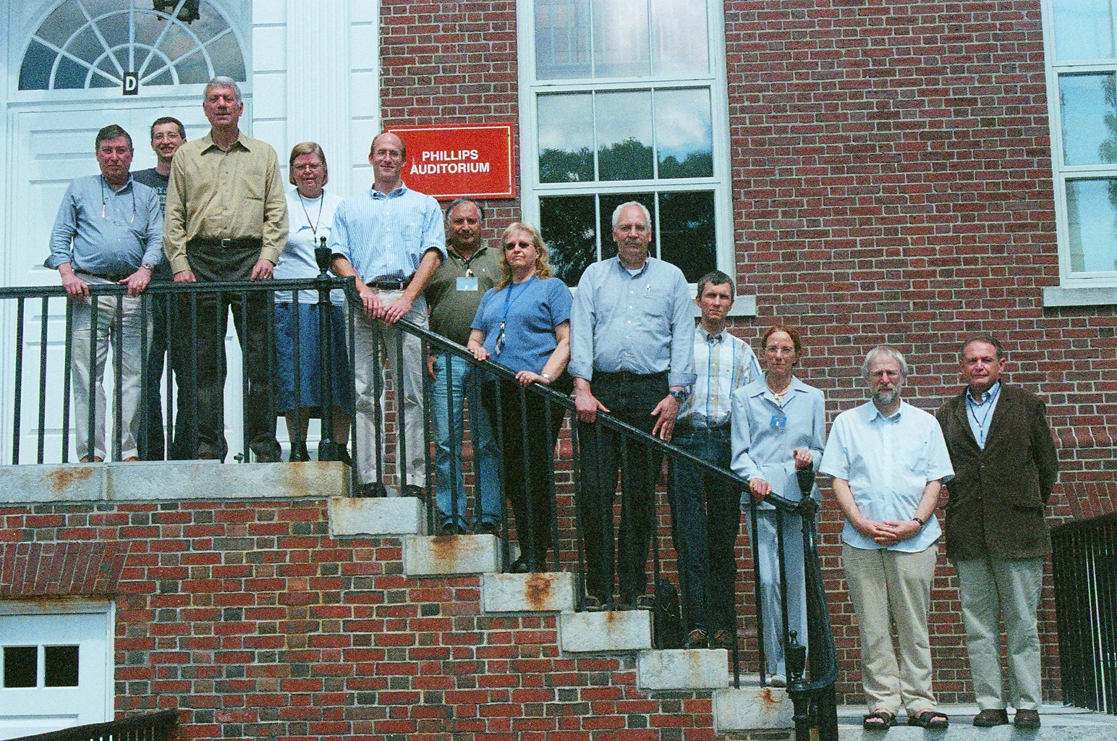
HITRAN International Advisory Committee (2008)

Slide 27
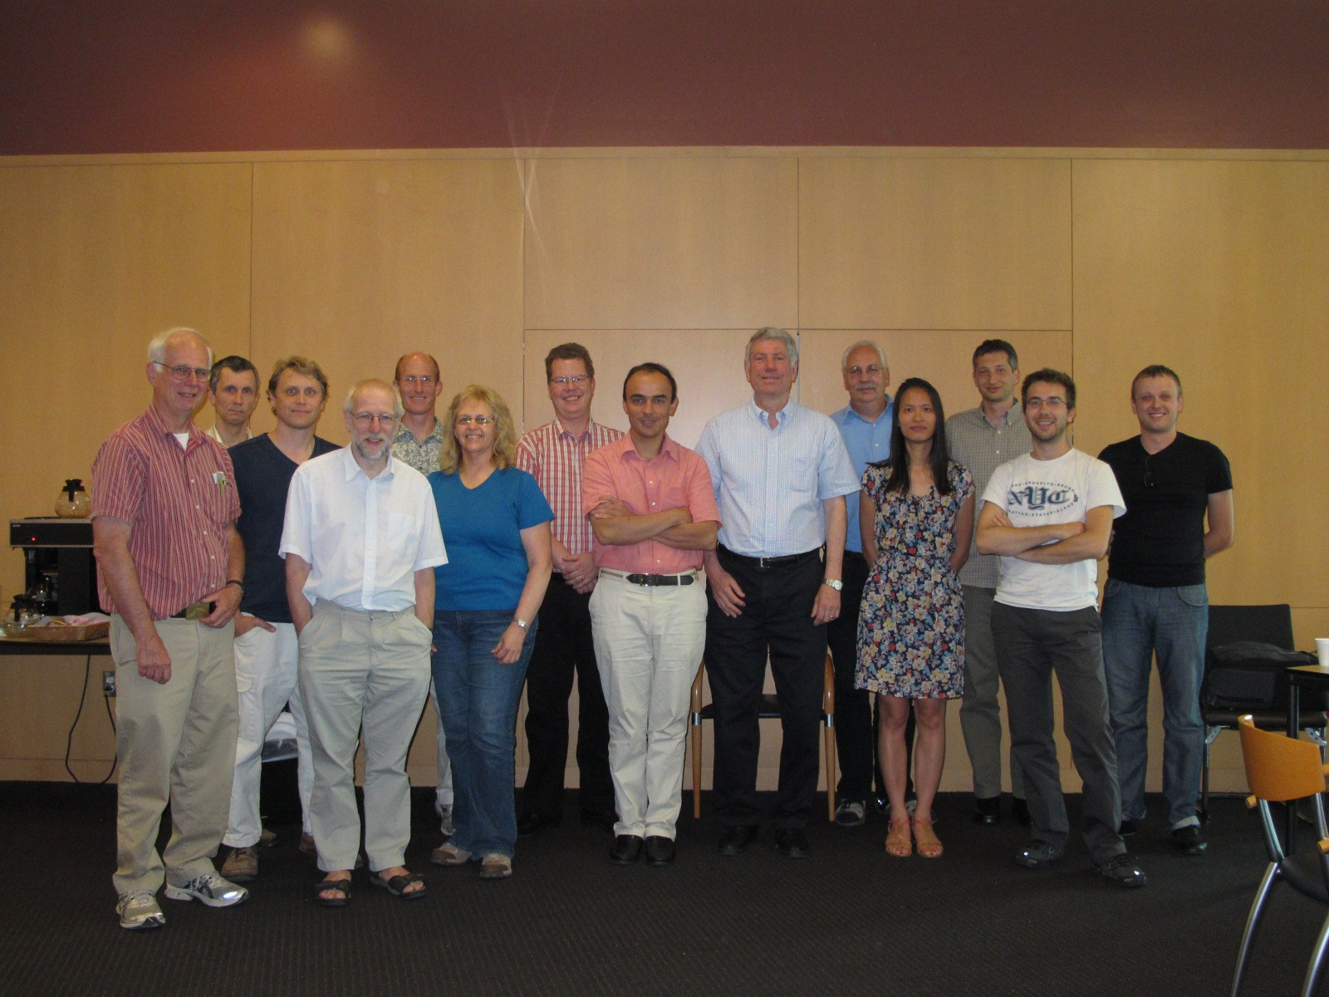
HITRAN International Advisory Committee (2011)

