Slide 1




Laboratory Measurements of Primordial Chemistry.
Daniel Wolf Savin
Columbia Astrophysics Laboratory
Xavier Urbain
Université catholique de Louvain

Slide 2
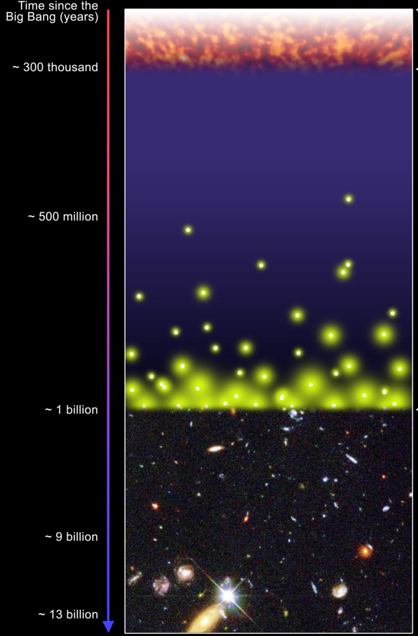
Outline
~ 377 thousand
I. H⁻ + H → H₂ + e⁻
a. Importance
b. Experiment
c. Results
II. H⁻ + H⁺ → H + H
a. Importance
b. Experiment
c. Results
III. H + H + H → H₂ + H
a. Importance
b. Experiment?
~ 15 million
First Stars
(Pop III)

Slide 3
Outline
~ 377 thousand
I. H⁻ + H → H₂ + e⁻
a. Importance
b. Experiment
c. Results
II. H⁻ + H⁺ → H + H
a. Importance
b. Experiment
c. Results
III. H + H + H → H₂ + H
a. Importance
b. Experiment?
~ 15 million
First Stars
(Pop III)

Slide 4

Structure formation in the early universe
γ
As volume decreases temperature increases
Gravity
H(0.9)
γ
H₂ (.01%)
γ
He (0.1)
Li (10⁻¹⁰)
Cloud cools by
H Lyα radiation
T 8,000 K
γ
What happens below 8,000 K?

Slide 5

Molecular H₂ can radiatively cool the gas down to T ~ 200 K.
Notes:
5

Slide 6
H₂ Formation during Epoch of Protogalaxy and First Star Formation
Associative detachment (AD)
H⁻ + H → H₂ + e⁻
How well do we understand this simple reaction?
And what are the cosmological implications?

Slide 7
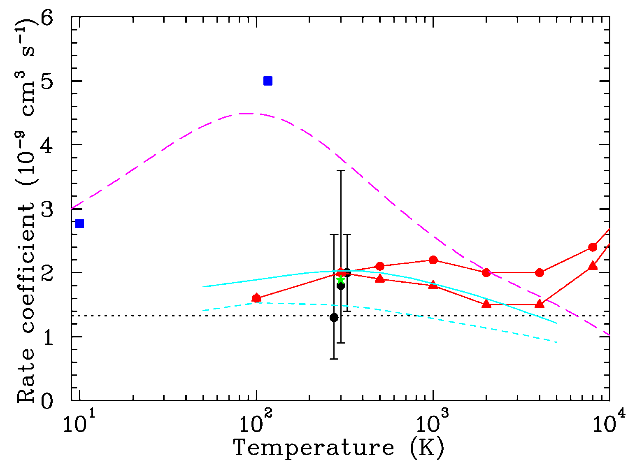
Published AD data for H⁻ + H → H₂ + e⁻
There is nearly an order of magnitude spread!
What are the cosmological implications of this?
Notes:
Explain why there are discrepancies. Where do the data come from.

Slide 8
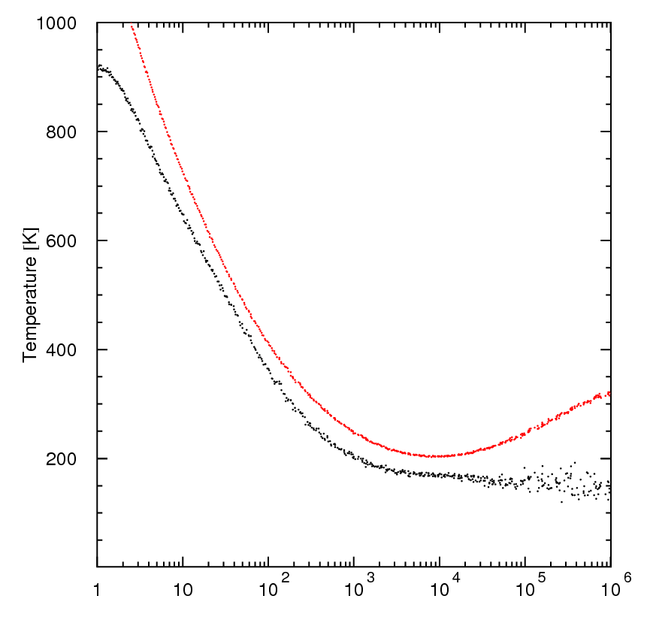
Implications for Protogalaxy Formation
Initially ionized gas (Pop III.2).
3D simulation.
Curves is for limits of H⁻ + H → H₂ + e⁻ rate coefficient.
M_{J} uncertain by factor of 20.
Fragmentation mass scale related to T_{gas} minimum (Larson MNRAS 2005).
Temperature (K)
Number density n (cm⁻³)
(Kreckel et al. 2010, Science, 329, 69)
Notes:
Initial density 10 cm⁻³.
Assuming z≈20 at t=0, results extend to z≈5.

Slide 9
Outline
~ 377 thousand
I. H⁻ + H → H₂ + e⁻
a. Importance
b. Experiment
c. Results
II. H⁻ + H⁺ → H + H
a. Importance
b. Experiment
c. Results
III. H + H + H → H₂ + H
a. Importance
b. Experiment?
~ 15 million
First Stars
(Pop III)

Slide 10
We use a merged beams technique.
Notes:
10

Slide 11
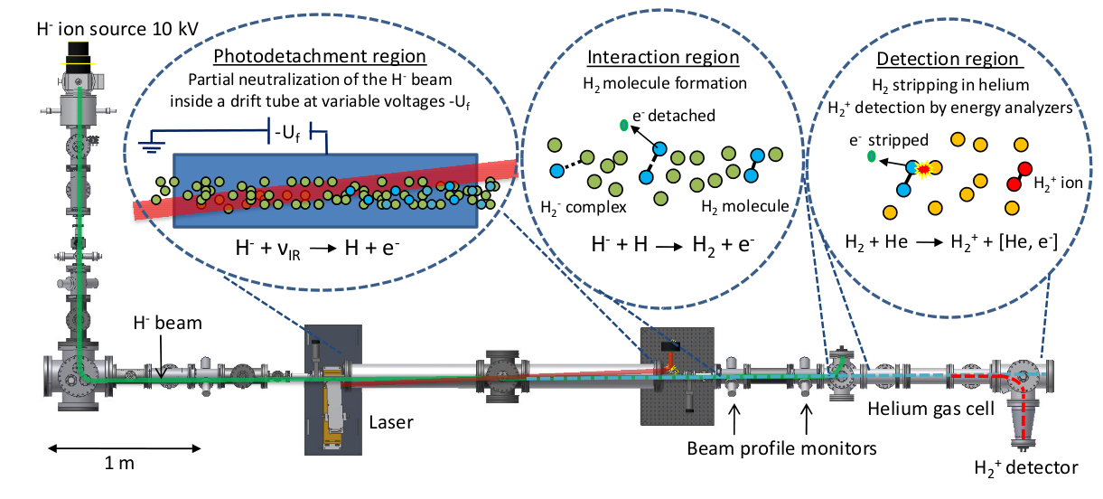
We use a merged beams technique.
Notes:
11

Slide 12
We use a merged beams technique.
Notes:
12

Slide 13
We use a merged beams technique.
Varying the floating cell potential U_{f} allow us to control the relative energy between the beams.
Notes:
13

Slide 14
We use a merged beams technique.
Notes:
14

Slide 15
We use a merged beams technique.
After the AD process E_{H2} ≈ E_{H}- + E_{H} ≈ 20 keV.
Notes:
15

Slide 16
We use a merged beams technique.
How to separate the 100 s⁻¹ H₂ from the 10¹¹ s⁻¹ of H?
Notes:
16

Slide 17
We use a merged beams technique.
We do this by ionizing ~ 5% of the H₂ and H.
Notes:
17

Slide 18
We use a merged beams technique.
We do this by ionizing ~ 5% of the H₂ and H.
Notes:
18

Slide 19
We use a merged beams technique.
The signal-to-noise ratio at this point is ~ 10⁻⁹.
Notes:
19

Slide 20
We use a merged beams technique.
We use an electrostatic energy analyzer to separate the 20 keV H₂⁺ from the 10 keV H⁺.
Notes:
20

Slide 21
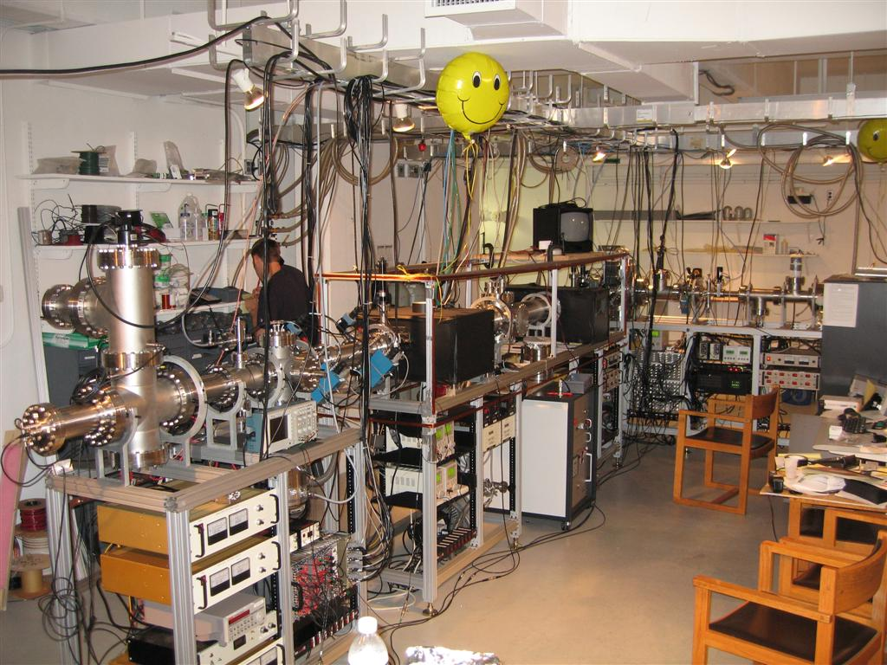
The day after we first got signal.

Slide 22
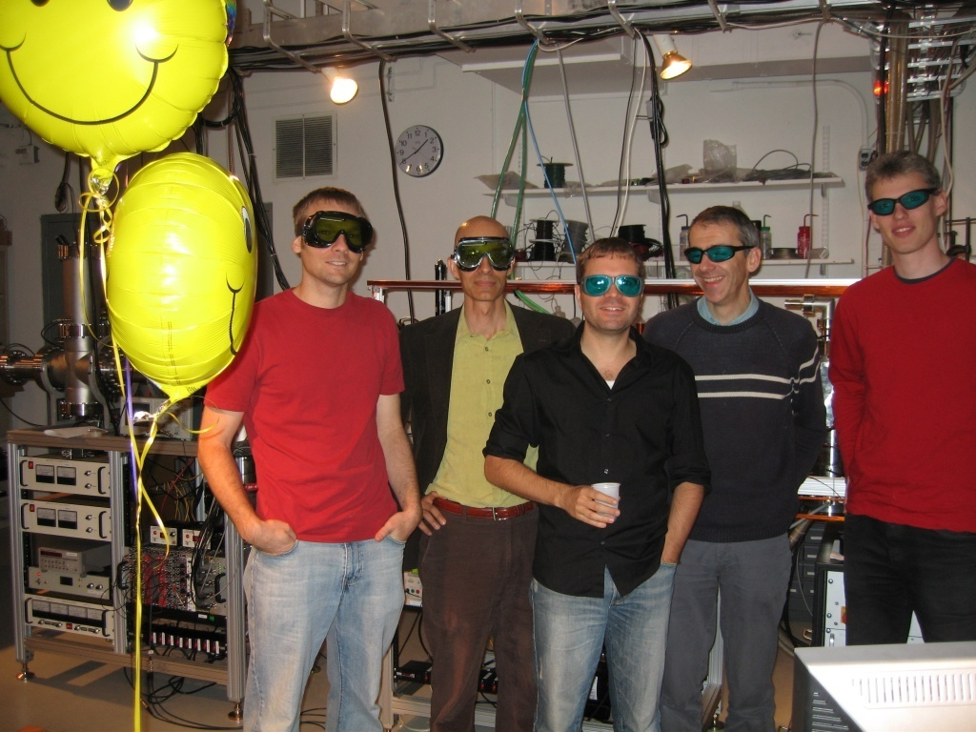
Celebrating our success!
K. A. Miller, DWS, H. Kreckel, X. Urbain, H. Bruhns

Slide 23
Outline
~ 377 thousand
I. H⁻ + H → H₂ + e⁻
a. Importance
b. Experiment
c. Results
II. H⁻ + H⁺ → H + H
a. Importance
b. Experiment
c. Results
III. H + H + H → H₂ + H
a. Importance
b. Experiment?
~ 15 million
First Stars
(Pop III)

Slide 24
The experimental AD rate coefficient
Beam densities
Converting R_{H2+} to R_{H2}
Overlap factor (emission measure)
Notes:
24

Slide 25
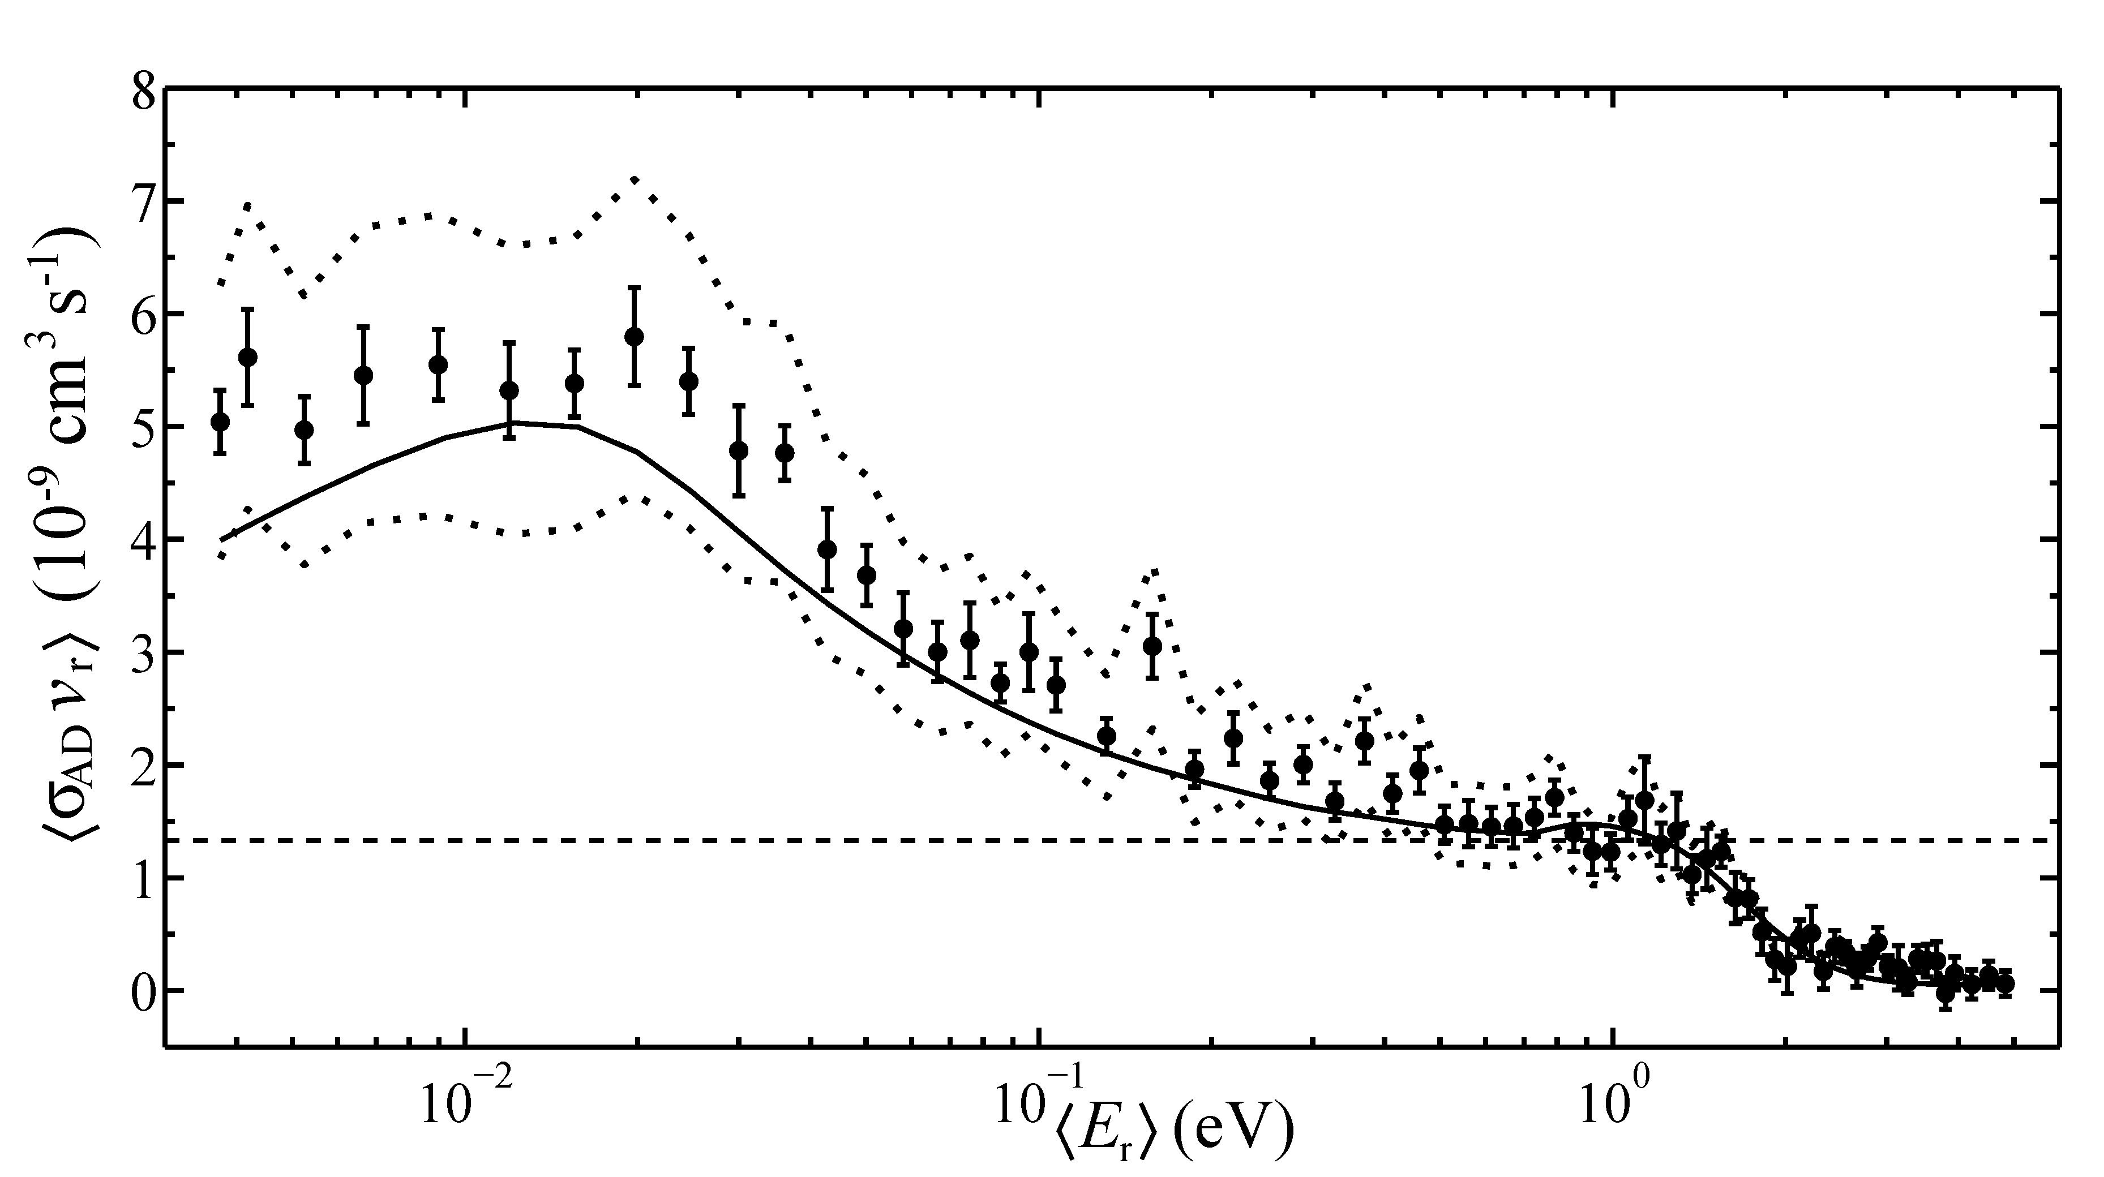
Our measured AD rate coefficient
Circles – data points
Error bars – 1σ statistics
Dotted – systematics
Solid – Čížek et al.
Dashed – Langevin
Kreckel et al. 2010, Science 329, 69
Miller et al. 2011, PRA, 84, 052709
Excellent agreement with Čížek et al. in both energy dependence and magnitude.
Notes:
25

Slide 26

Rate coefficient implications
Good agreement with Čížek et al. suggests past experimental and theoretical work is incomplete.
Notes:
26

Slide 27
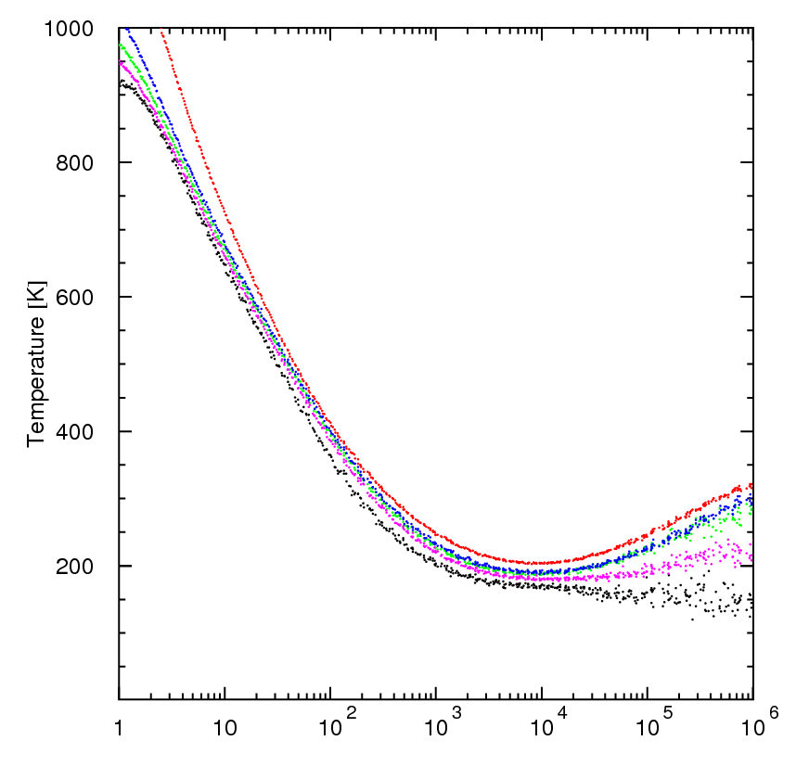
Implications for Protogalaxy Formation
Initially ionized gas (Pop III.2).
3D simulation.
Red & black due to previous AD uncert.
Other points show new ±25% uncert.
M_{J} uncertainty goes from 20 to 2!
Fragmentation mass scale related to T_{gas} minimum (Larson MNRAS 2005).
Temperature (K)
Number density n (cm⁻³)
(Kreckel et al. 2010, Science, 329, 69)
Notes:
Initial density 10 cm⁻³.
Assuming z≈20 at t=0, results extend to z≈5.

Slide 28
Outline
~ 377 thousand
I. H⁻ + H → H₂ + e⁻
a. Importance
b. Experiment
c. Results
II. H⁻ + H⁺ → H + H
a. Importance
b. Experiment
c. Results
III. H + H + H → H₂ + H
a. Importance
b. Experiment?
~ 15 million
First Stars
(Pop III)

Slide 29
H⁻ destruction reduces H₂ formation
H⁻ + H⁺ → H + H
There is nearly an order of magnitude spread!
Notes:
Explain why there are discrepancies. Where do the data come from.

Slide 30
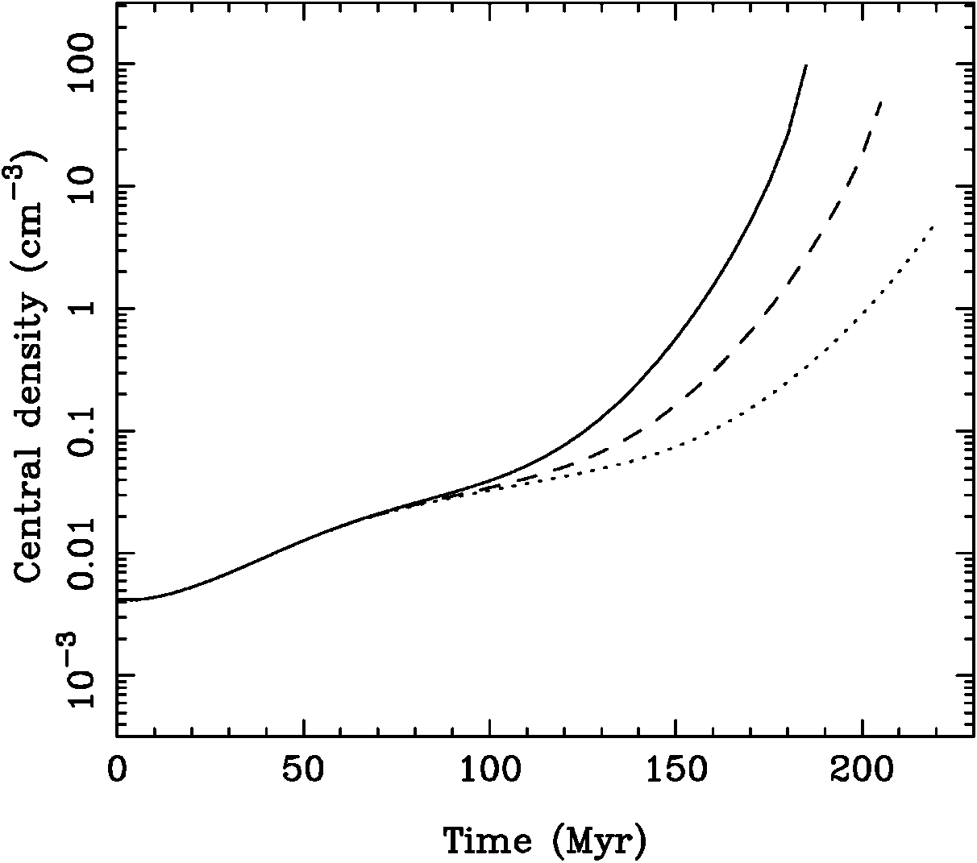
Implications for Protogalaxy Formation
Initially ionized gas.
3D simulation.
Each curve is for different values of H⁻ + H⁺ → H + H.
Can a cloud form a protogalaxy before it is gravitationally disrupted?
(Glover et al. 2006, ApJ, 641, 157)
Notes:
Initial density 10 cm⁻³.
Assuming z≈20 at t=0, results extend to z≈5.

Slide 31
Outline
~ 377 thousand
I. H⁻ + H → H₂ + e⁻
a. Importance
b. Experiment
c. Results
II. H⁻ + H⁺ → H + H
a. Importance
b. Experiment
c. Results
III. H + H + H → H₂ + H
a. Importance
b. Experiment?
~ 15 million
First Stars
(Pop III)

Slide 32
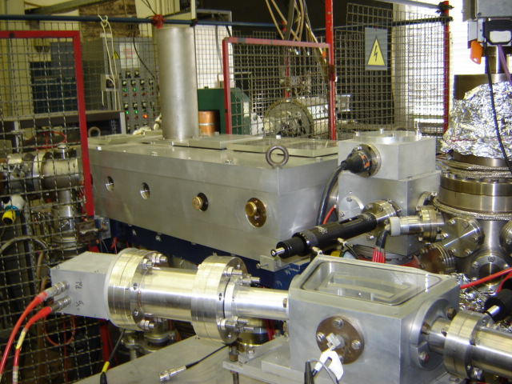
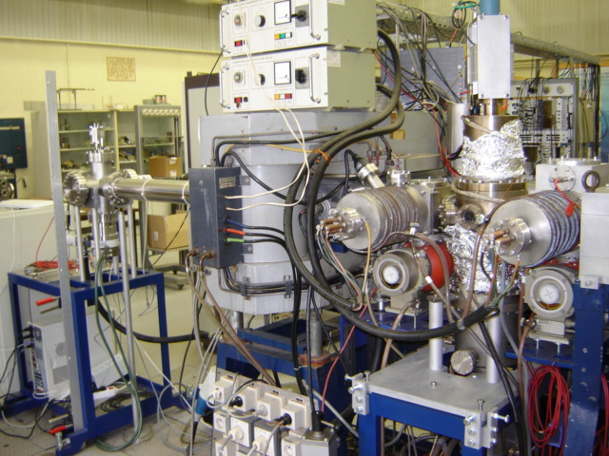
Experimental setup at UCLouvain
Detectors for MN products
ECR (H⁺)
Mutual neutralization
H⁺ + H⁻ → H + H
10⁻¹⁰ mbar
H⁻
Bias cell
H⁺
Duoplasmatron (H⁻)
Associative ionization
H⁺ + H⁻ → e⁻ + H₂⁺
Magnet
CEM for AI products

Slide 33
Outline
~ 377 thousand
I. H⁻ + H → H₂ + e⁻
a. Importance
b. Experiment
c. Results
II. H⁻ + H⁺ → H + H
a. Importance
b. Experiment
c. Results
III. H + H + H → H₂ + H
a. Importance
b. Experiment?
~ 15 million
First Stars
(Pop III)

Slide 34
Outline
~ 377 thousand
I. H⁻ + H → H₂ + e⁻
a. Importance
b. Experiment
c. Results
II. H⁻ + H⁺ → H + H
a. Importance
b. Experiment
c. Results
III. H + H + H → H₂ + H
a. Importance
b. Experiment?
~ 15 million
First Stars
(Pop III)

Slide 35
What was the mass of the first stars?
AD and MN important for Pop III.2 formation.
Both important when cloud is < 0.01% H₂.
Both play key role in setting upper limit for M_{J}.
But mass of the first stars still a big unknown.
Depends on physical conditions of initial cloud.
It also depends on the chemistry that converts the cloud to fully molecular H₂.
Notes:
35

Slide 36
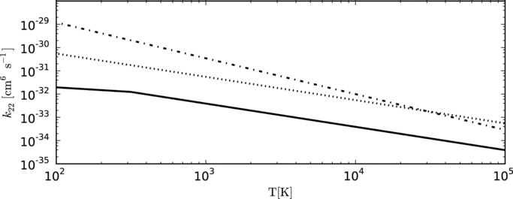
How does the cloud go fully molecular?
Three Body Association (3BA)
H + H + H → H₂ + H
Abel et al. (2002)
Palla et al. (1983)
Flower & Harris (2007)
(Turk et al. 2011, 726, 55)
Uncertain by factor of ~ 100 at relevant T.
Important in both Pop III.1 and III.2 formation.

Slide 37
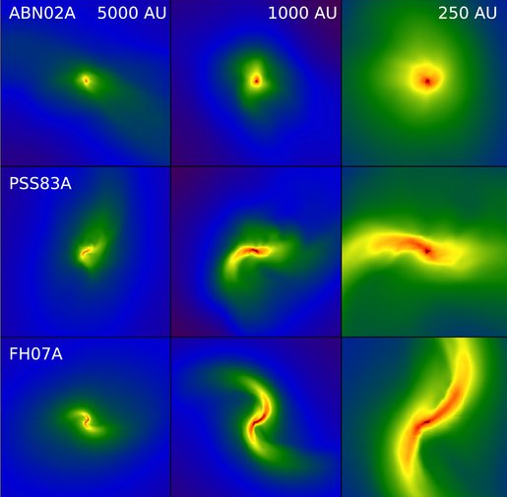
Implications of 3BA uncertainty.
(Turk et al. 2011, ApJ, 726, 55)
Has potentially important implications for ability of gas to fragment and form multiple stars.

Slide 38
Outline
~ 377 thousand
I. H⁻ + H → H₂ + e⁻
a. Importance
b. Experiment
c. Results
II. H⁻ + H⁺ → H + H
a. Importance
b. Experiment
c. Results
III. H + H + H → H₂ + H
a. Importance
b. Experiment?
~ 15 million
First Stars
(Pop III)

Slide 39
Experimental challenges of measuring
H + H + H → H₂ + H
How to create a volume of neutral H largely uncontaminated?
How to separate neutral daughter H₂ from neutral parent H?
Somehow create H₂⁺ in a volume V ≈ 1 mm³.
Rate coefficient α ≈ 10⁻³³ – 10⁻³⁰ cm⁶ s⁻¹.
R = αn_{H}³V and for R = 1 s⁻¹ gives n_{H} ≈ 10¹² cm⁻³.

Slide 40
How to generate n_{H} ≈ 10¹² cm⁻³ ?
Compressed spin polarized H
  T ~ 600 mK is too low.
H Bose-Einstein condensates
  nK temperatures.
Photodetachment of H⁻
  n_{H} ≈ 10³ cm⁻³.
Discharges
  Chemistry too complex.
Tokamak neutral beam injectors
  n_{H} < 10¹⁰ cm⁻³ (70% pure).
Cracked atom source
  n_{H} < 10¹⁰ cm⁻³ (99% pure).
Pulsed gas jet discharges
  n_{H} < 10¹⁰ cm⁻³ (~ 30% pure).
Is it beyond current lab capabilities?

Slide 41
Conclusions
We have performed the first energy dependent measurements for the H⁻ + H → H₂ + e⁻ reaction.
We have resolved the dilemma of the low energy behavior of H⁻ + H⁺ → H + H.
Both these results will improve cosmological models for protogalaxy and first star formation.
Experimental studies of H + H + H → H₂ + H seem just beyond current technical capabilities.

Slide 42




Collaborators
Hjalmar Bruhns, Holger Kreckel, M. Lestinsky,
Ken A. Miller, W. Mittumsiri, B. Seredyuk,
M. Schnell, B. Schmitt
Julien Lecointre, Ferid Mezdari
Simon C. O. Glover
Universität Heidelberg,
Germany
Martin Čížek
Charles University
Prague, Czech Republic
M. Rappaport
Weizmann Institute of Science,
Rehovot, Israel
C. C. Havener
Oak Ridge National Lab
And lastly...
Notes:
42

Slide 43
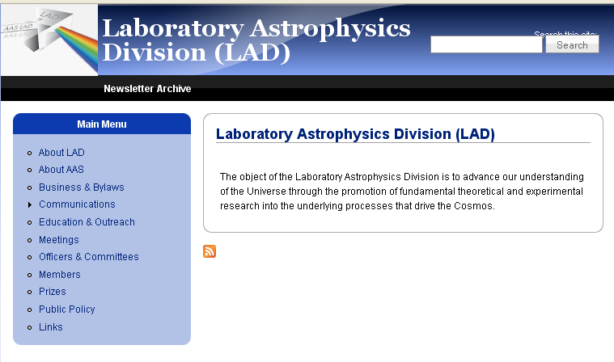
American Astronomical Society formed new division this year
http://lad.aas.org

