Slide 1
Charge Exchange Spectroscopy of
Multiply Charged Ions of Industrial and
Astrophysical Interest
3rd October, 2012
ICAMDATA, NIST, USA
Hajime TANUMA
Department of Physics
Tokyo Metropolitan University

Slide 2
Activity of Atomic Physics Group in TMU
Electrostatic Ion Storage Ring (E-ring)
RCE
(resonant coherent excitation)
H. Shiromaru, J. Matsumoto,
T. Azuma, T. Majima,
H. Tanuma, K. Hansen
T. Azuma (RIKEN)
10 - 30 keV
GeV
Drift Tube
(ion swarm at 4.3 K)
ECRIS
(highly charged ions)
H. Tanuma
H. Tanuma
0.5 - 100 meV
1 - 100 keV
Ion Mobility Spectrometry:
Detection of chemical warfare agents

Slide 3
Contents of this talk
Charge Exchange Spectroscopy
Industrial part :
EUV lithography
Xe and Sn ions
Astrophysical part :
Solar Wind Charge Exchange
bare and H-like O, N, C ions
3

Slide 4
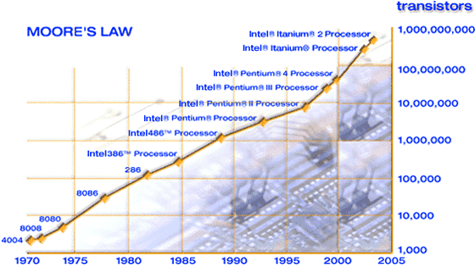

Moore’s Law
“The number of transistors incorporated in a chip will
approximately double every 24 months.”
Gordon Moore, Intel Co-founder (1965)

Slide 5
Light Sources for the Photo-Lithography
Hg lamp g-line λ = 436 nm ( -1989)
Hg lamp i-line λ = 365 nm (1990-1994)
KrF laser λ = 248 nm (1995-2002)
ArF laser λ = 193 nm (1994- )
Higher Integration = Shorter Wavelengh
What is the next ?
That is (was) EUV@13.5 nm !
That will be 6.x nm.

Slide 6
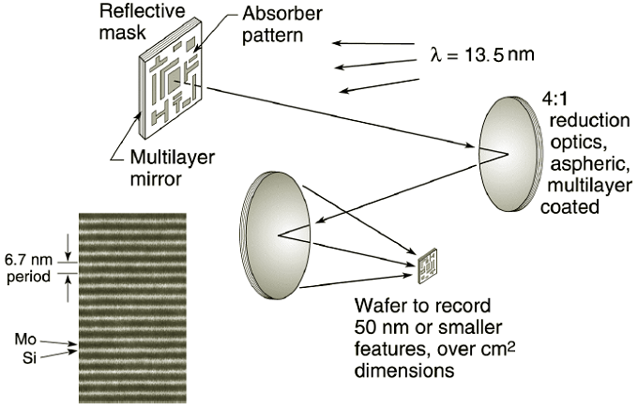
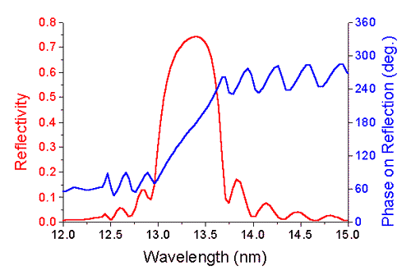
Light Source ? = Plasma of Xe or Sn
max ~ 13.5nm
Principle of the EUV lithography
EUV = Extreme Ultra-Violet
( 13.5 nm = 91.8 eV )
Reflectivity of Mo-Si multi-layer mirror

Slide 7
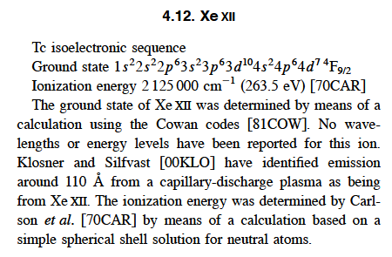
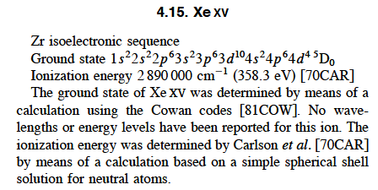
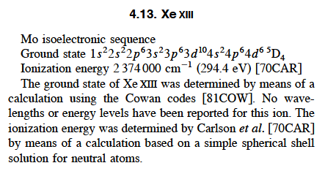
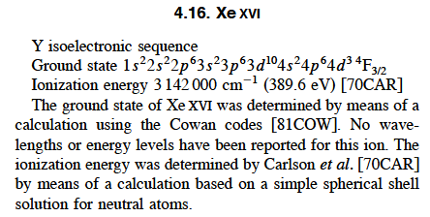
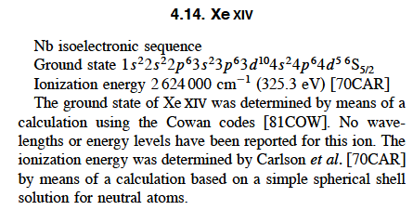
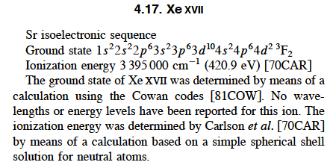
Atomic data compilation by E. B. Saloman, NIST
No wavelengths or energy levels have been reported for Xe XII - Xe XVII.
J. Phys. Chem. Ref. Data 33 (2004) 765-921.
Our strategy to obtain the atomic data on Xe ions :
Collision-induced EUV emission
Charge Exchange EUV Spectroscopy

Slide 8
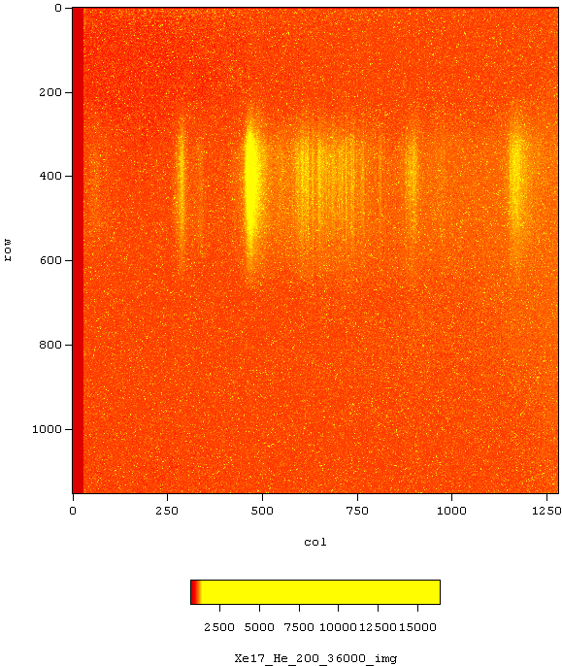
Experimental Setup
CCD image
ECRIS
( E = 20q keV )
Xe^{q+}, Sn^{q+} ( i = 0.1 - 1eμA )
collision
center
differential pumping
Grazing Incident Spectrometer
hν
target gas
(He, Ar, Xe)
liq. N₂ cooled CCD
P_{CC} = 3 x 10⁻⁶ Pa
TMP
TMP
↓ target gas
P_{GIS} = 3 x 10⁻³ Pa
P_{CC} < 1 x 10⁻³ Pa
Notes:
実験装置の概略図です．
ECRイオン源より引き出された多価Snイオンを，磁場で価数選別し，衝突領域に導きます．
衝突領域では標的気体と多価イオンが衝突し，電荷移行反応における発光を斜入射回折分光器で分光し，CCDに記録します．
標的気体としては主にHeとXeを用いました。
また，横軸はO⁵⁺やO⁶⁺の発光ラインを用いて波長校正をしました．
スペクトルの図でノイズか発光ラインかの判断が付きにくいものについては，最終的にこのCCDの画像より判断しました．
(Next Page)

Slide 9
Experimental Results on Xe^{q+}
( q = 7 - 18 )

Slide 10
He gas target
Xe gas target
Emission of (q-1)+ ions

Slide 11
Xe⁶⁺

Slide 12
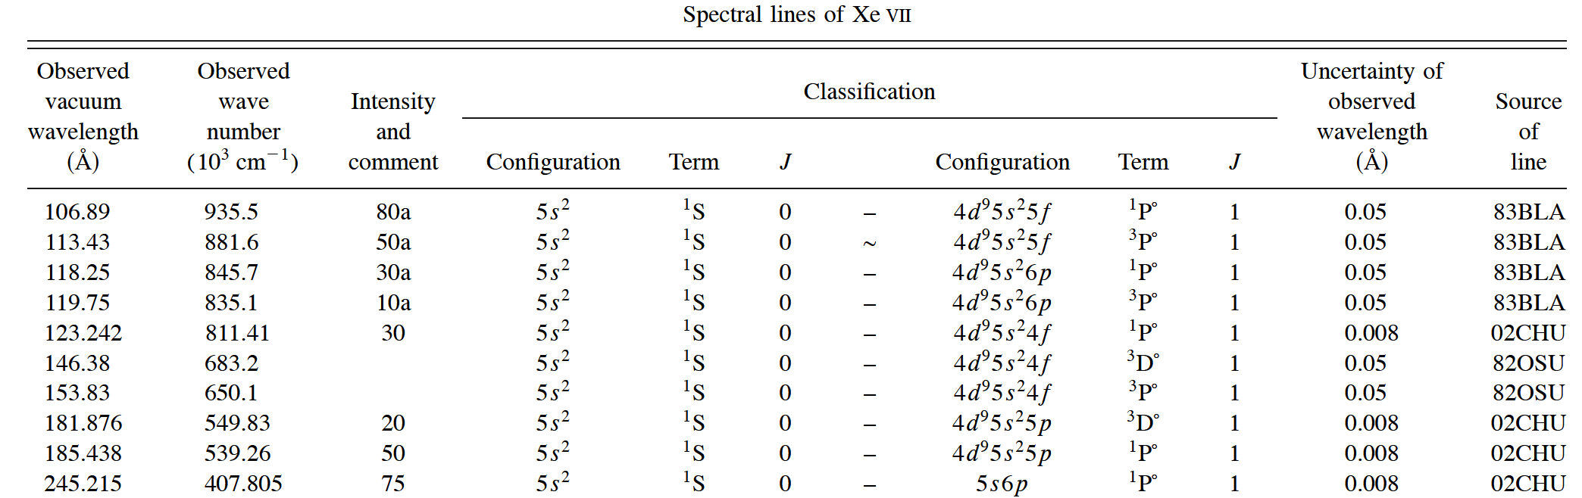
Emission lines of Xe⁶⁺ in the Saloman’s report
only 9 lines in 6 - 24 nm
( total 131 lines )

Slide 13
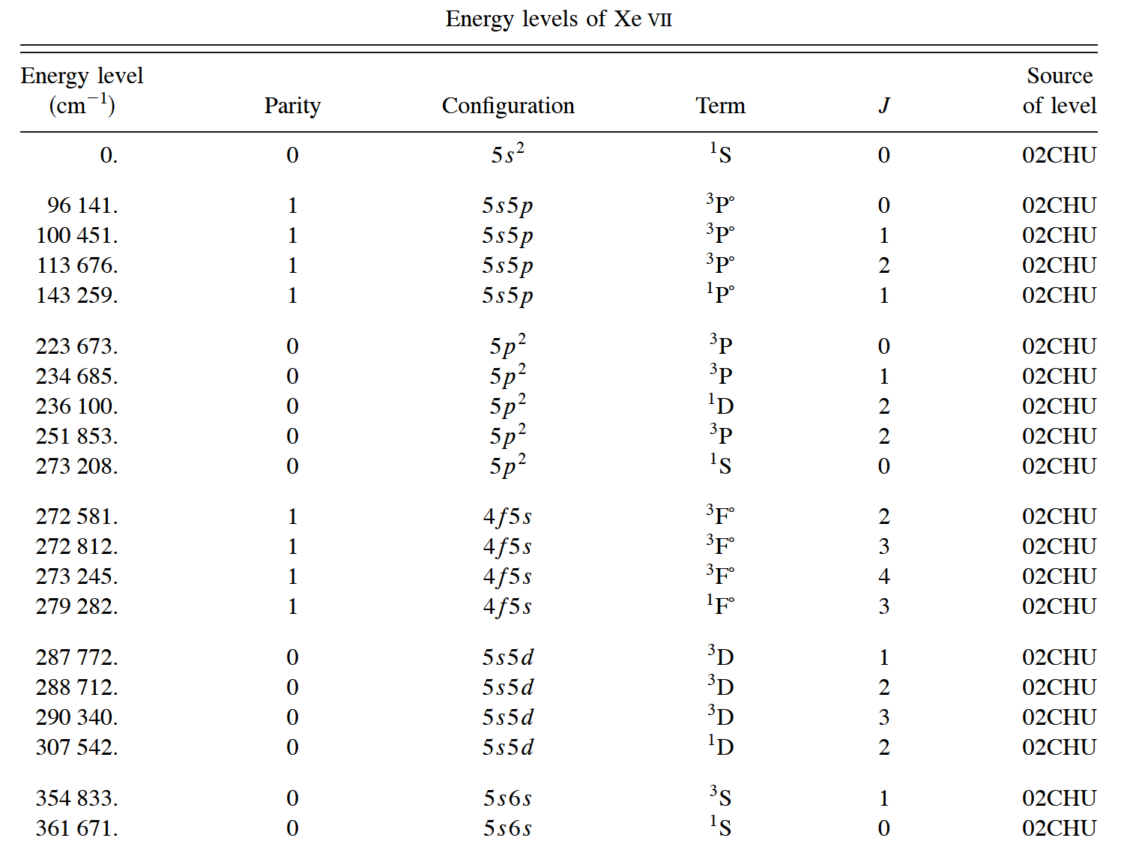
Energy levels of Xe⁶⁺ in the Saloman’s report
72 levels give ₇₂C₂ = 2556 lines.

Slide 14
Identification of emission lines of Xe⁶⁺
Ground State : Xe⁶⁺ [Kr]4d¹⁰5s²
4 new transitions

Slide 15
Summary of Xe spectra analysis :
Xe⁶⁺ : 4 lines, 4 new transitions
Xe⁷⁺ : 22 lines, 8 new transitions
Xe⁸⁺ : 39 lines, 9 new transitions
H. Tanuma et al., Phys. Rev. A 84 (2011) 042713.
q ≥ 9 : too many lines to identify perfectly for us
eg. UTA (un-resolved transition array)

Slide 16
Average transition wavelengths
Systematic discrepancy in 4d-4f = Configuration interaction
(F. Koike)

Slide 17
Experimental Results on Sn^{q+}
( q = 5 - 21 )

Slide 18
Sn^{q+}
H. Ohashi et al., J. Phys. B 43 (2010) 065204.

Slide 19
Collaborators in Industrial part :
experiment :
Dr. Hayato Ohashi (TMU → Univ. Electro-Communication)
Dr. Shinsuke Fujioka (ILE, Osaka Univ.)
Prof. Hiroaki Nishimura (ILE, Osaka Univ.)
theory :
Dr. Akira Sasaki (APR, JAERI)
Prof. Fumihiro Koike (Kitasato Univ.)
Prof. Katsunobu Nishihara (ILE, Osaka Univ.)
Dr. Rebekah D’Arcy (University College Dublin)
Prof. Gerry O’Sullivan (University College Dublin)
Acknowledgement :
This work financially supported in part by MIXT (Ministry of Education, Culture, Sports, Science and Technology, Japan) under contact subject
“Leading Project for EUV lithography source development”.

Slide 20
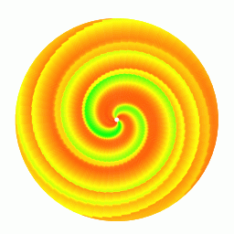
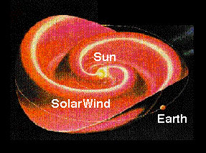
Solar Wind = extremely thin plasma
- Negative : e⁻ ~ 10 cm⁻³ around the Earth
- Positive : H⁺ ~ 95%
He²⁺ ~ 4%
C^{q+}, O^{q+}, Ne^{q+}, Mg^{q+}, Si^{q}+, S^{q+} etc.
- Velocity : 200-400 km/s, 700-900 km/s
(0.21 - 4.2 keV/u)

Slide 21

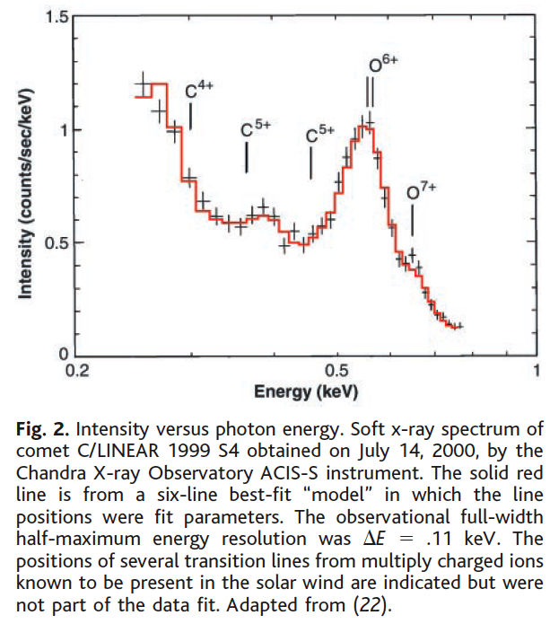
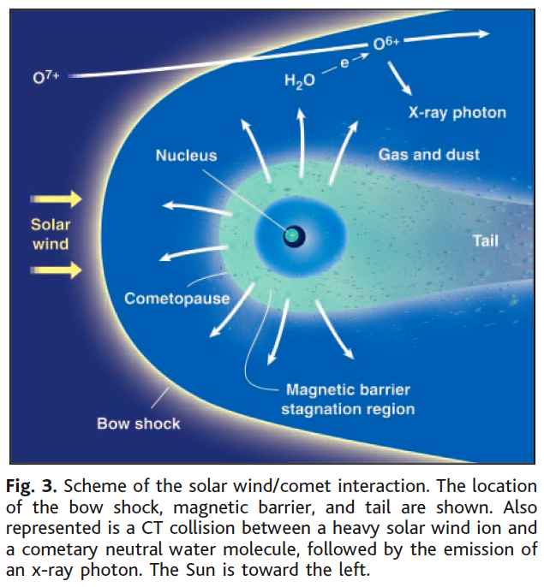

Slide 22
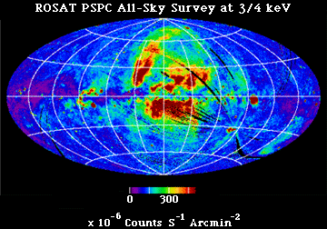
3/4 keV diffuse background map from the ROSAT all-sky survey.
At 3/4 keV, the sky is dominated by the relatively smooth extragalatic background and a limited number of bright extended Galactic object.

Slide 23
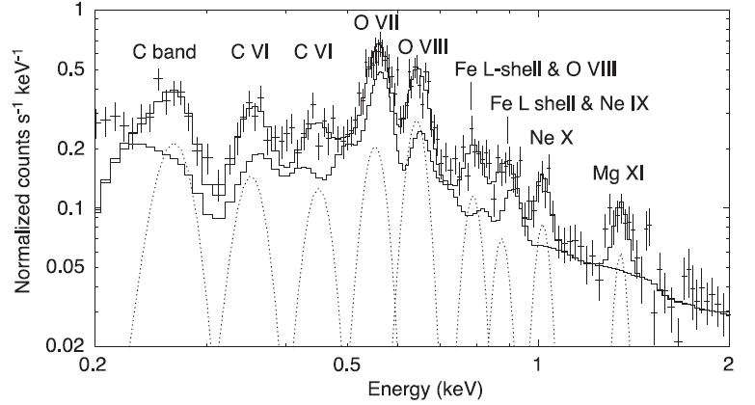
Background soft X-ray by Suzaku
O⁶⁺(1s²-1s2p)
574 eV
O⁷⁺(1s-2p)
654 eV
Low resolution ~ 100 eV
R. Fujimoto et al., Publ. Astron. Soc. Japan 59 (2007) S133–S140.

Slide 24
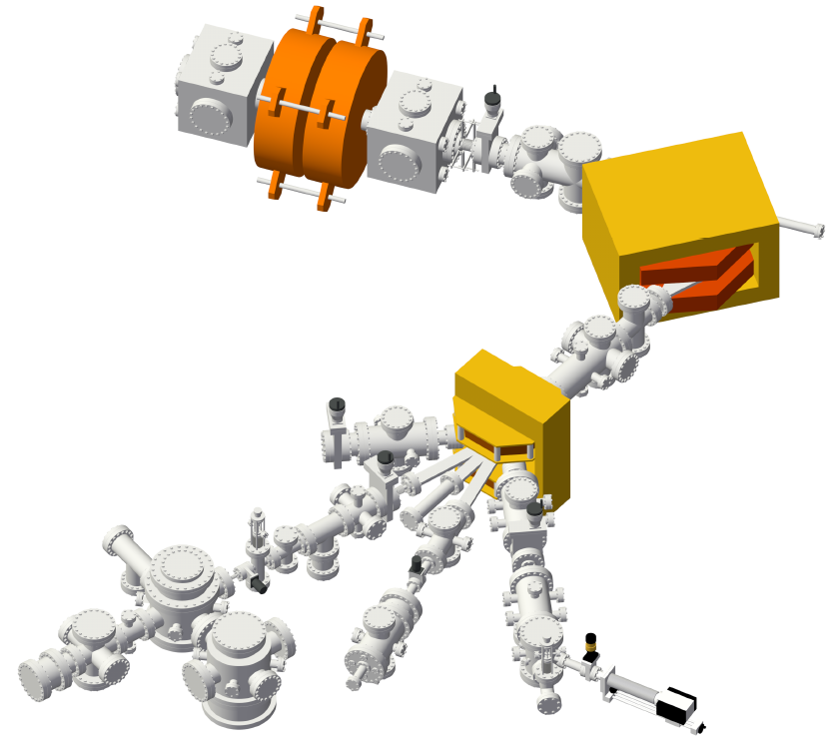
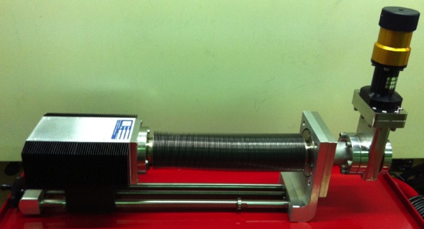
New experimental setup (1)
Analyzing
Magnet
14.25 GHz
ECR Ion Source
Switching
Magnet
Window-less
Silicon Drift Detector
(SDD)

Slide 25
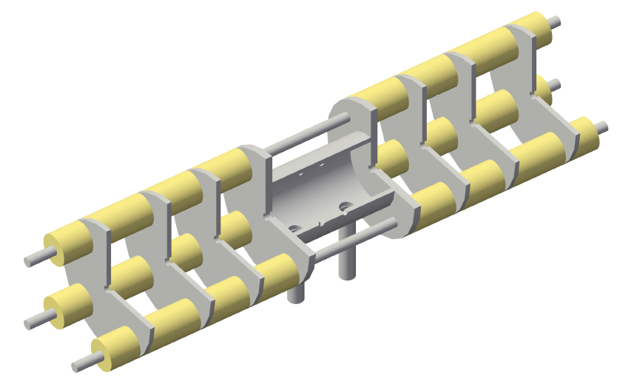
New experimental setup (2)
Ion Beam
Collision Cell
to capacitance
manometer
target
gas inlet
Magic Angle = 54.736°

Slide 26
Experimental spectra in collisions of O⁸⁺ ions with H₂ and He

Slide 27
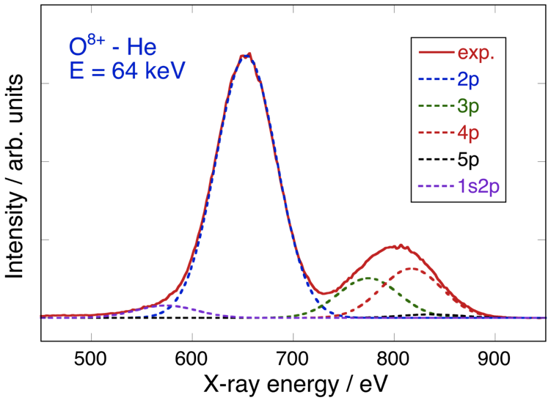
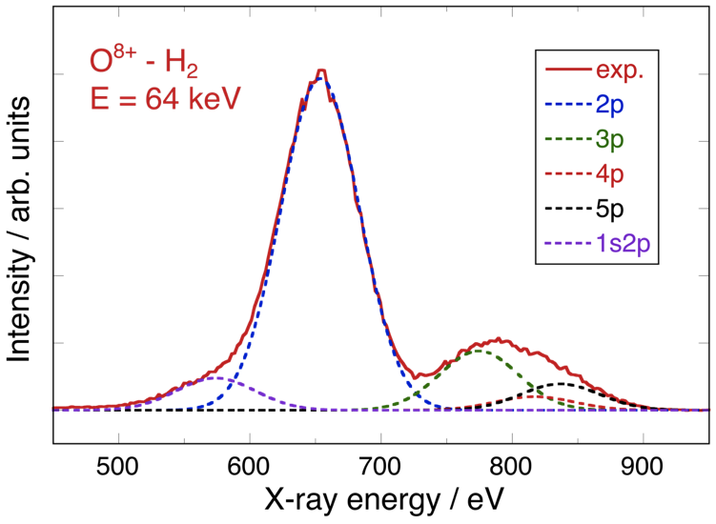
O⁸⁺ - He / H₂ collisions
1s-np transitions of O⁷⁺, and 1s²-1s2p transition of O⁶⁺
2p > 4p > 3p
2p > 3p > 4p

Slide 28
Comparison with theoretical calculations
Atomic Orbital Close Coupling calculation by L. Liu & J. Wang

Slide 29
Partial cross sections
Dominant capture level : n = 5 (H₂), n = 4 (He)

Slide 30
Cascade of transitions
²S_{1/2}
²P_{1/2, 3/2}
²D_{3/2, 5/2}
²F_{5/2, 7/2}
n=5
n=4
n=3
n=2
Initial state distribution
n=1
Notes:
電荷移行の初期分布がこのようになります。
このようにカスケードが起こり
発光します

Slide 31
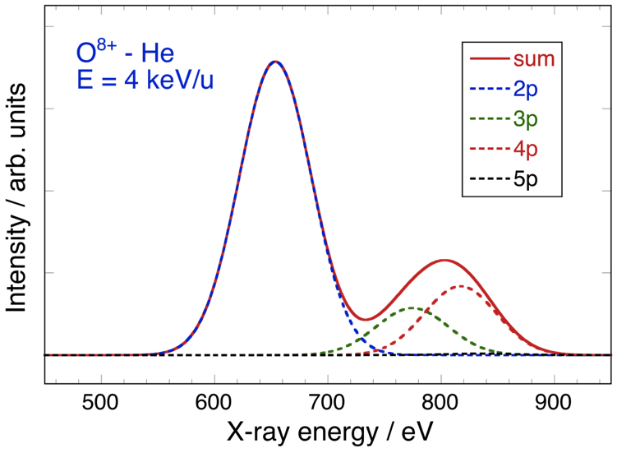
O⁸⁺ - He collisions
Agreement is almost perfect, except for 1s²-1s2p.
2p > 4p > 3p
2p > 4p > 3p

Slide 32
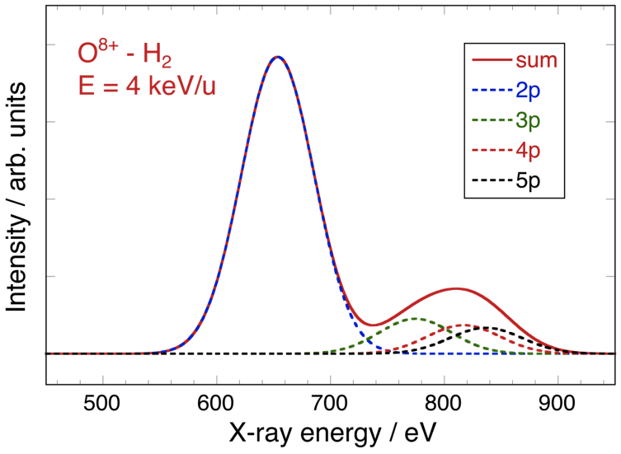
O⁸⁺ - H₂ collisions
Agreement is not sufficient, due to molecular structure (?)
2p > 3p > 5p > 4p
2p > 3p ~ 5p ~ 4p

Slide 33
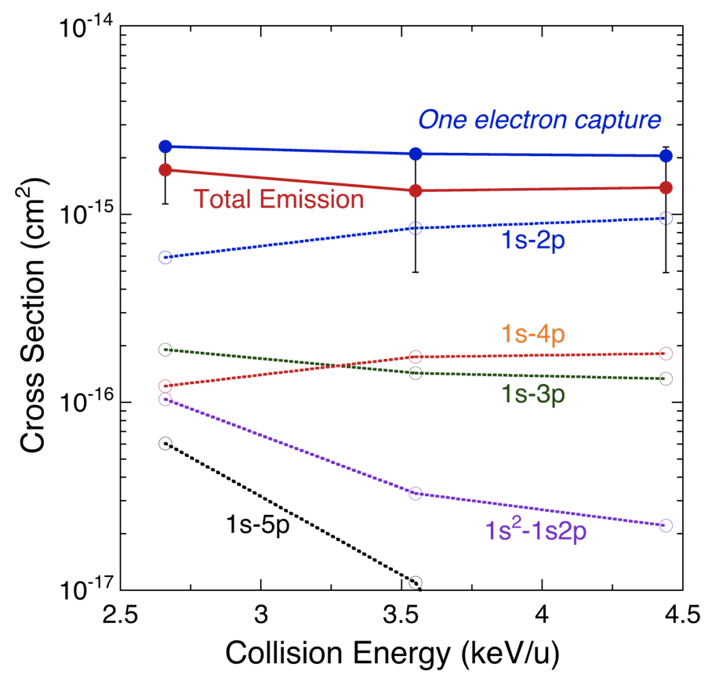
Cross Sections : O⁸⁺ - He
difference
Preliminary Data
1s – 2s : M1, 2E1
1s – np : E1

Slide 34
Collaborators in Astrophysical part :
Atomic Physics Group, Tokyo Metropolitan University
H. Shimaya, T. Ishida, T. Kanda, S. Ishikawa, S. Suda
Astrophysics Group, Tokyo Metropolitan University
H. Akamatsu, Y. Ishisaki, T. Ohashi
JAXA / ISAS: K. Shinozaki, K. Mitsuda
IAPCM in Beijing: Ling Liu, Jianguo Wang
University of Electro-Communication: H. Ohashi, N. Nakamura
- Development of a new spectrometer
Sophia University: K. Okada
- Development of an ion trap

Slide 35
What’s next?
Collaboration with National Institute for Fusion Science in Japan :
Charge exchange spectroscopy for W ions
Cross section measurements of W ions with He and H₂ gas
Collaboration with Astrophysicists in Japan :
Systematic measurements of capture and emission cross sections
High-resolution spectroscopy for inter-combination lines
Measurements with an atomic hydrogen target
Observation of forbidden transitions of He-like ions by an ion trap
Introduction of a TES micro-calorimeter in our laboratory

Slide 36
Thank you for your attention.
謝謝
御静聴ありがとうございました。

